Slide 1

Officiating Pickleball
2023
Day 1
© 2023 USA Pickleball
01/31/2023
Notes:
Welcome to the first day

Slide 2

2023 Referee Training
Hosted and Presented by
_____________________
USA Pickleball Registered Trainer
USA Pickleball Certified Referee

Slide 3
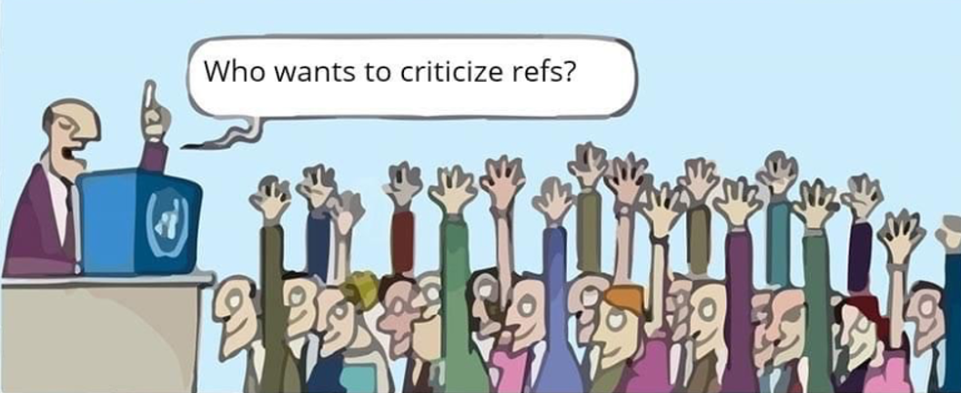
Notes:
We all do it – we think we can do better that what we see on TV and on the courts at tournaments

Slide 4
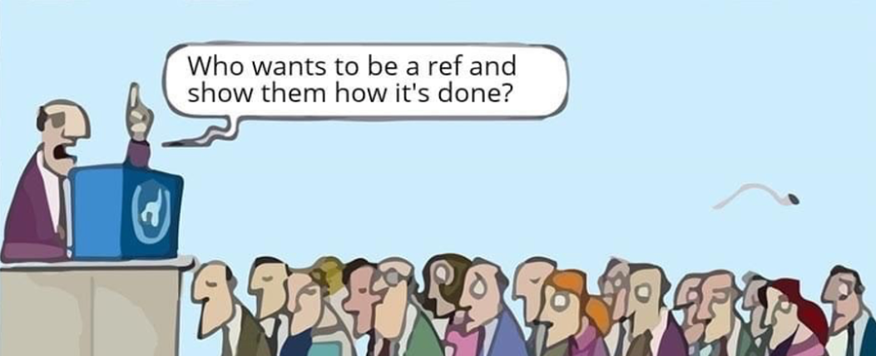
Notes:
Your participation in this course and hopefully continuing your referee journey afterwards gives you a chance to show everyone what a good referee is and does – we’d all rather have no referee rather that a bad referee. Becoming a referee does not mean you have to become a Certified Referee. There are tiered referee levels along the way. You can choose how far you want your referee journey to go.
Why become a referee? There are several reasons:
Help you learn about All pickleball rules
Give you something fun to do between games or on your off days at tournaments
Help stay involved in the sport you love even if you are injured and cannot play
Become a resource to other players, and
- Earn a little pocket money at tournaments.

Slide 5
General Course Outline
(Section References correspond the USAP Officiating Handbook)
Day 1:
Introduction (slides 1 – 5)
Section 1: Responsibilities and Code of Conduct for Referees (slides 6 - 16)
Key Rule Changes for 2023 and Key Definitions of Terms (slides 17 - 25
Section 2: Referee Tools (slides 26 – 30)
Section 3: Referee Match Preparation and Scorekeeping Procedures (slides 31 – 53)
Section 4: Refereeing a Match (Doubles Play) (slides 55 – 92)
End of Day 1 – Resources & Questions (slides 92 – 96)
Day 2:
Follow-up from Day 1 & Quiz (slides 97 – 103)
Section 4: Refereeing a Match (Doubles Play) (slides 103 – 141)
Section 5: Key Situations and Rules Violations (slides 142 – 185)
End of Day 2 – Resources & Questions (slides 186 - 187)
Day 3:
Follow-up from Day 2 (slides 188 - 198
Section 5: Key Situations and Rules Violations (slides 198 – 211)
Section 6: Player Behavior and Remedies (slides 212 – 245)
Section 7: Dual Referee Option and New Sanctioning Formats (slides 246 – 250)
Section 8: Medal Matches with Line Judges (slides 251 – 271)
End of Day 3 – Conclusion, Next Steps & Questions (slides 272 – 277)

Slide 6
USA Pickleball Referee Certification Is NOT Required To Referee
Becoming a USA Pickleball Level 1/Level 2/Certified Referee enables you to be proficient at applying
USA Pickleball Rules & Officiating Handbook
Best Practices!
Notes:
The next few slides will focus on the responsibilities of referees and expectations of the conduct of referees on and off the court
Why do we have referees? So that matches are conducted fairly and flow smoothly throughout the tournament.
The referee is an enabler - not an inhibitor = matches are about the players and the game - NOT about the referee

Slide 7
Primary Purpose of the USA Pickleball Referee Training/Certification Program
Improve Officiating Competency across the U.S through:
Standardization
Consistency
Professionalism
Notes:
The primary purpose of referee training is to improve the officiating competency - this is accomplished in three ways

Slide 8
Standardization
Series of standardized resources including:
2023 USAP/Official Rulebook
2023 Rule Changes Document
2023 USA Pickleball Officiating Handbook*
2023 USA Pickleball Casebook for Referees*
On-Demand Referee Training Videos*
Online Testing Series
Referee Quick-Start Video
Referee Training PowerPoint (basis for this course)
Available online at usapickleball.org
*Requires USAP Membership

Slide 9
Consistency
Players deserve consistency
Referees doing the same thing, the same way, at the same time
Practice is key
Professionalism
Code of Conduct
Impartiality
Respect
Fairness
Transparency
Notes:
Consistency is measured by each referee is officiating the same way in every match in every tournament.
It also means that if a player is participating in a tournament in AZ or CA or FL they deserve referees adhering to the same standards and procedures – they know what to expect
The key to achieving consistency is practice, practice, practice!
Professionalism is further define by the officiating code of conduct as “professional with a pleasant demeanor”.

Slide 10
Code of Conduct
Professional With a Pleasant Demeanor
Be Respectful
Avoid Overfriendliness
Avoid Emotional Reactions
Avoid Anger or Confrontation
Do Not Comment on Play
Notes:
We must enforce the USAP Rulebook & Officiating Handbook best practices.
If a situation isn’t covered by the rulebook or handbook, use goo common sense and judgement to address the situation. You can also call the Head Referee.
If we don’t sound confident and avoid mistakes, the players won’t have confidence in us.
Be respectful to everyone – confident, assured, but not dictatorially by using a professional demeanor throughout.

Slide 11
Code of Conduct
ALWAYS Enforce Rules in Accordance with USAP Rulebook & Officiating Handbook “Best Practices”
Use Common Sense and Good Judgement when Addressing Situations Not expressly covered by the Rulebook or Officiating Handbook
Use a Professional and Pleasant Demeanor at All Times
Treat Players, Line Judges, Other Referees and Spectators with Respect
Display Confidence in Your Actions and Rulings
Avoid Being Dictatorial
Avoid Being Distracted - Devote Your Full Attention to the Match Being Played.
Notes:
We must enforce the USAP Rulebook & Officiating Handbook best practices.
If a situation isn’t covered by the rulebook or handbook, use goo common sense and judgement to address the situation. You can also call the Head Referee.
If we don’t sound confident and avoid mistakes, the players won’t have confidence in us.
Be respectful to everyone – confident, assured, but not dictatorially by using a professional demeanor throughout.

Slide 12
Code of Conduct
Excuse Yourself from Refereeing a Relative, Close Friend or Doubles Partner Where it may be perceived to be a conflict of interest.
Keep an Upright Stance and be Attentive
DO NOT:
Use any Device that Would Interfere with Play – cell phone/umbrella, etc.
Intervene in another Match in Progress During a Tournament Unless Asked to do so by the Referee or the Tournament Director
Make Derogatory Comments about or Critique any On-Court Matters, Decisions or the Performance of Another Referee in Public, Including Social Media
Make Comments on Any Player in Public, Including on Social Media (positive or negative) as it Can be Seen as Lacking in Impartiality.
Notes:
You will be expected to stand for the entire match. You need to devote your full attention and not lose focus during the match.
Players do sometimes act aggressively or get angry. Remember, it is not personal and don’t get angry yourself or escalate the confrontation – maintain a clam demeanor and diffuse/de-escalate the situation.
Avoid overfriendliness by making comments about play (great play/great shot) We need to be total impartial without any appearance of favoritism.
Now let’s look at some “dos” and “don’ts”

Slide 13
Code of Conduct (cont’d)
DO:
Turn Phone Off or to Vibrate
Excuse Yourself from Refereeing a Relative, Close Friend or Doubles Partner Where it may be perceived to be a conflict of interest.
Keep an Upright Stance and be Attentive
Dress appropriately
Be What You Would Like Your Referee To Be
Notes:
If you use your phone for information about court assignments make sure it is on vibrate. Make sure any alarm settings are off.
Refereeing a match with someone you know well may appear to be favoritism.
More and more tournaments have specific dress requirements for referees. Make sure you know them and abide by them.
The most important thing to remember is to “be what you would like your referee to be”

Slide 14
Primary Responsibilities
Interpret and Enforce the Rules
Keep & Announce Score Correctly
Track Correct Server/Receiver
Check Server & Receiver Positioning (for Faults)
Call Service, No-Volley Zone & Short Service Faults – Immediately
Maintain Control of the Match
Notes:
These responsibilities are listed in order of their importance.
There is nothing that erodes a player’s confidence in a referee if they cannot keep the score accurately.
Just as important is the ability to track and recognize the correct server/receiver and the correct server/receiver positioning – the are potential faults
Remember, all other line calls are the responsibility of the players or line judges.

Slide 15
Primary Responsibilities (cont’d)
Keep Match Moving Efficiently
Recognize Violations, Apply Rules & Resolve Disputes
Rule On Line Calls Only When Appealed By A Player (unless a line judge’s view is blocked and the referee clearly saw the ball as “in” or “out”)
Issue & Track Warnings/Fouls
Ensure Court is Safe for Play
Notes:
Maintaining control of the match and keeping the match moving efficiently is important for the players as well as helping to maintain the tournament schedule.
Resolving disputes doesn’t happen very often, but when they occur you need to remain in control – you have the final word on the court – we’ll talk about how to do this and avoid a confrontation later
Issuing and tracking warnings and fouls are one of the most important referee tools for maintaining control of unruly players – well cover that in the future.
Ensuring court safety includes hinders/ball rolling across the court, foreign substances or blowing debris/sand and players from an adjacent court running on the court.
Recognize violations and interpret and enforce the rules , with discretion and common sense

Slide 16
It Is All About Increasing Competency
Standardization/Consistency/Professionalism
The Match Is About The Players and The Game and a Successful Tournament
NOT The Referee
The Referee is a Facilitator
The Most Successful Referee
Is The One
No One Remembers After The Match
Notes:
The best referee is one who you don’t remember – there were no significant mistakes, the match progressed smoothly and nothing bad happened that we within the referee’s control

Slide 17
2023
KEY
RULE CHANGES
EFFECTIVE 1/1/23

Slide 18
Key 2023 Rules Changes
Serve
Spin Serve - One-handed spin serve is prohibited for both the Volley and
the Drop Serves (4.A.5.e and 4.A.7.c).
- “while some natural rotation of the ball is expected during any release
of the ball from the hand, the server shall not impart manipulation or
spin on the release of the ball prior to the serve”.
Replay or Fault on the Serve – if the referee is not certain whether a
serving motion violation occurred, the referee may call a replay. The
referee may also call an immediate fault if the referee is certain that a
service violation occurred (4.A.6 and 4.A.8) (Does NOT include foot faults)

Slide 19
Key 2023 Rules Changes (cont’d)
Player Questions about Correct Server/Receiver or Position (4.B.8)
Before the serve occurs, any player may ask the referee who is the correct server or receiver or whether any player is in an incorrect position. A generic question like “Am I good” may be asked and shall be considered to encapsulate both the correct server question and the correct position questions if asked by the serving team.

Slide 20
Key 2023 Rules Changes (cont’d)
Wrong Score Called (4.K)
The 2022 rule change prevented a player from stopping play
after the serve due to a wrong score being called. This caused confusion for many players.
The 2023 rule change reverts back to the 2021 wording which permitted play to be stopped to correct the score by anyone before the return of serve.
Stopping play after the return of serve because of a wrong score called will result in a fault.

Slide 21
Key 2023 Key Rules Changes
Broken or Cracked Ball (11.E)
If a cracked ball has been discovered, the rules have previously provided a means of deciding what action can be taken.
Beginning in 2023, a ball that is deemed to be degraded or soft has been added to read “if a ball is degraded, soft, broken or cracked”.
If, in the judgement of the referee, a cracked or broken ball impacted the outcome of a rally, the referee will call a replay with a replacement ball.
For a “degraded or soft” ball, if both teams agree that the ball is either degraded or soft, the ball will be replaced, BUT there will be no replay of the prior rally

Slide 22
Key 2023 Key Rules Changes
Equipment Time-Out (10.D)
An equipment time-out can be taken without a player needing to use a
regular time-out and the time permitted can be of “a reasonable duration”.
Apparel (2.G.1 and 2.G.4)
A player may be required to change their apparel if the color “approximates
the color of the ball”.
The Tournament Director (TD) has the authority to enforce apparel changes
and players may use a non-chargeable time-out to comply.
A player who refuses to comply, the TD may declare a forfeit of the match.

Slide 23
Key 2023 Rules Changes (cont’d)
Tiebreakers in Round-Robin Matches (12.C.3.a)
The method of using tiebreakers to decide round-robin winners in sanctioned tournaments has been modified to make it easier to decide which team/player won.

Slide 24
Key Definition of Terms
3.A.3 Court – The area inside the outer dimensions of the baselines and sidelines.
3.A.26 Playing Surface – The court and the area surrounding the court designated for playing.
3.A.19 Live Ball/In Play – The point in time when the referee or server (or server's partner) starts to call the score.
3.A.5 Dead Ball – A ball that is no longer in play.
Notes:
Not here to make or push people into the Certification process

Slide 25
Key Definition of Terms (cont’d)
End of court – The Court & Playing Surface, the space between the net and baselines for both teams/players.
Side of court – The left or right side of the court, also known as the odd (left) side & even (right) side of the court
3.A.39 Starting Server – For each doubles team, the player designated to serve first at the start of the game. In doubles tournament play, the starting server shall wear a visible form of identification determined by the Tournament Director.
3.A.12 First Server – In doubles, the player who shall serve from the right/even side of the court after a side out, according to the team’s score.
Notes:
Not here to make or push people into the Certification process

Slide 26
Basic Officiating Tools
Stopwatch/Timing Device
Numbered Clip for Tracking Server
Band Aids
Two Pencils With Eraser
2+ Tournament Balls
Clipboard & Scoresheet (provided by Event Ops/Ref Desk)

Slide 27
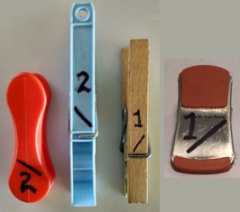
Basic Officiating Tools (cont’d)
Numbered Clip For Tracking Server

Slide 28
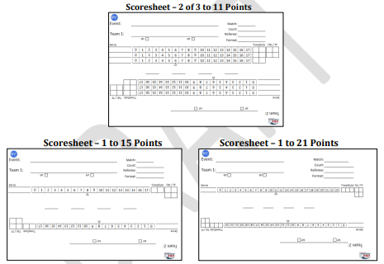
USA Pickleball/Pickleball Tournaments.com Scoresheets

Slide 29
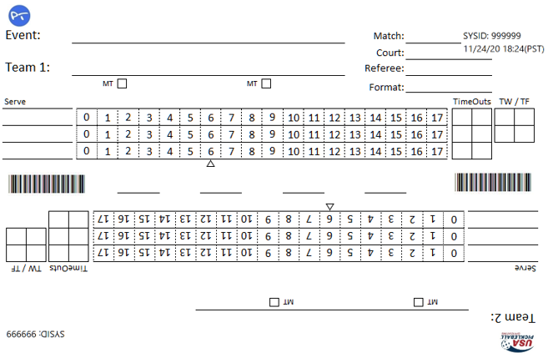
Typical Three-Game Scoresheet 2021 Changes

Slide 30
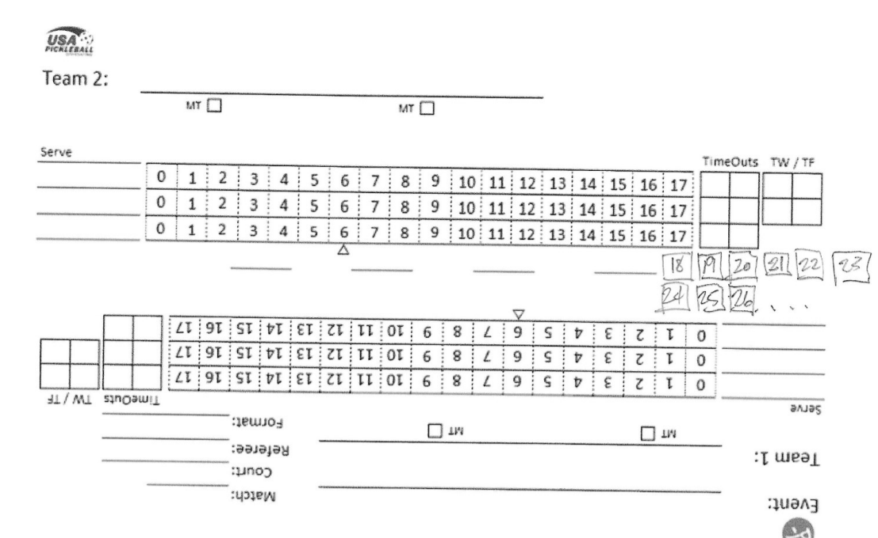
What if the Scores Exceed the Number of Boxes on the Scoresheet?

Slide 31
Basic Refereeing Procedures
Before Each Tournament:
Review the Current USA Pickleball Rulebook
Re-read Officiating Handbook
Review Online Referee Casebook
Retake Online Referee & LJ Tests
usapickleball.org/get-involved/pickleball-officiating

Slide 32
Basic Refereeing Procedures
Before the Match:
Prepare mentally & physically
Pick up referee tools and personal items in advance
Know venue court layout
Pick up scoresheet & activate timer immediately when match is called.
Know the number of minutes allowed to start the match after the match is called

Slide 33
Basic Refereeing Procedures (cont’d)
When Your Name is Called to Referee
Immediately collect the match scoresheet & clipboard
Start your timer!
Quickly review information on the scoresheet
Player Names – conflict of interest?
Court Number
Match Format
Verify “1” or “2” on the back of the scoresheet
Proceed to your Court Without Delay!

Slide 34
At the Court
Enter/Exit Court With Players
Enforce tournament rules about bags/etc. on the courts.
Check Portable Net Heights & Positioning
Carry Two Official Balls For Match
Identify Safety Hazards/Obstacles
Choose Your On-Court Position:
Consider Sun, Shadows, Spectators, Distractions, Other Referees, Line Judges, etc.

Slide 35
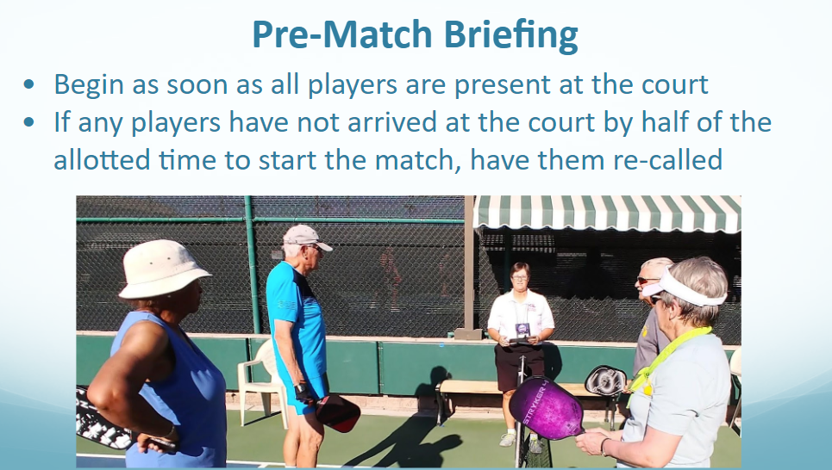

Slide 36
Pre-Match Briefing
Standard Briefing from Officiating Handbook
Don’t add anything except as directed by the TD.
Don’t repeat any information that the TD may provide to players prior to the tournament
Introductions, Confirmation of Players & Identification of Starting Servers
Provide prescribed tournament starting server identification
State Match Format
Inspect Paddles for Irregularities & Confirm the Paddle is USA Pickleball Approved List

Slide 37
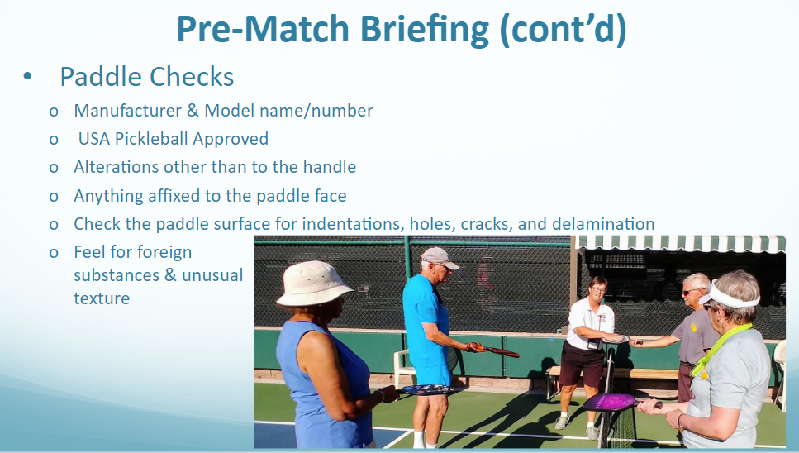

Slide 38
Pre-Match Briefing
Rule 2.E.7. Model Designation. The paddle must have a manufacturer-provided and clearly marked brand and model name or model number on the paddle. The brand and model information may be shown on the paddle by a manufacturer affixed decal.
There are NO exceptions the rule 2.E.7.
The model number or model name and manufacturer brand name must be on the paddle AND the paddle must be on the approved paddle list with the SAME EXACT NOMENCLATURE.
For example, if you are presented with a paddle with a “Series II” as part of the model name, but only “Series I” is on the approved paddle list, the paddle is illegal.
If the manufacturer affixed decal has been removed or is missing, the paddle is illegal.
Be aware:
In order to find a paddle on the approved list, you may sometimes need to search both the
model number or model name, or under the manufacturer name to find it.

Slide 39
Pre-Match Briefing (cont’d)
Review Line Calling Responsibilities (optional if TD provides in advance)
If a Player Indicates a Hearing Impairment, Determine what Level of
Support is Needed.
Check for Headphones/Earbuds (during play)
Except prescribed/necessary hearing aids
Explain Any Unique Conditions/Procedures
Determine End/Serve/Receive/Defer
Ask Players if They Have Any Questions
Begin/Continue Warm Up
Give “One-Minute End of Warmup” Notice

Slide 40
Pre-Match Briefing (cont’d)
Basic Pre-Match Briefing Script – Part 1: (adjust according to TD’s instructions)
“Hello, my name is ____________ I will be officiating this match. The format is (2/3 games or 1 game to 15/21)”
“Who are my teams?” (Confirm with names printed!)
“Who will be your starting server?” (circle name/ give wristband)
“May I see your paddles?” (check by sight and feel – do not ask if paddle is USAP approved)
“I will be calling the score and any short serves. I will be calling service faults as well as NO VOLLY ZONE faults.
“You are responsible for all other lines including the center line on the serve. Please make your OUT calls immediate, LOUD and CLEAR. If I do not hear a call, the ball is IN. You may appeal any call. If I did not see the ball clearly land, the call on the court will stand.”
Notes:
This is a key part of the “consistency” goal. NFL/NBA officials all say the same words in the same order every time – remember “You are the Actor and the Court is your stage” = Memorize your lines to achieve consistency.

Slide 41
Pre-Match Briefing (cont’d)
Basic Pre-Match Briefing Script – Part 2: (adjust according to TD’s instructions)
“Are there any questions?”
To any player: “Please choose a number, 1 or 2.” (SHOW the number on the back of your score sheet to ALL players)
To the winning team/player: “Would you like to serve, receive, choose end or defer?” (MARK)
If serve/receive is chosen, ask the remaining team to pick an end.
If end is chosen, ask the remaining team to choose serve or receive
If defer is chosen, the remaining team must choose serve/receive or end.
“You have _____ minutes remaining.”

Slide 42
Pre-Match Briefing (cont’d)
Referee Hints:
Briefing can be somewhat shortened as the day progresses
Use remaining time to complete your scoresheet & observe serves
Note any identifying characteristic for each player
Write EVEN above the starting servers names
Write ODD above their partners names
Along with marking the team that serves, identify the END as well (left/right, fence, north/south, gate, etc.)

Slide 43

Pre-Match Briefing (cont’d)
(Time stamp: 4:35 – 7:23)

Slide 44
Preparing Scoresheet
Mark Serving Team Each Game - “x” or Starting Server’s First Name in the “Serve” Column for Each Team
Circle Starting Server Each Team
Note Key Identification Clues for Players
Annotate Which End of the Court was Chosen by the Team that Made the Selection Under Team names.

Slide 45
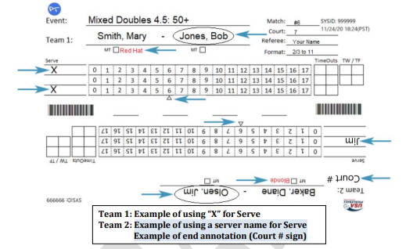
Preparing Scoresheet

Slide 46
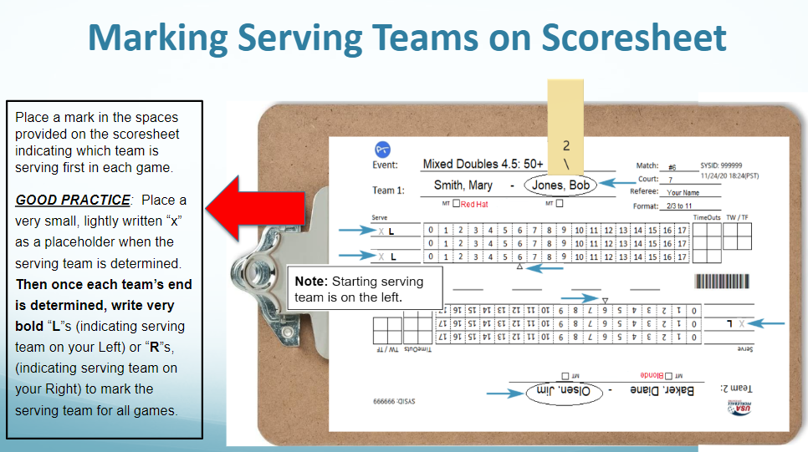

Slide 47
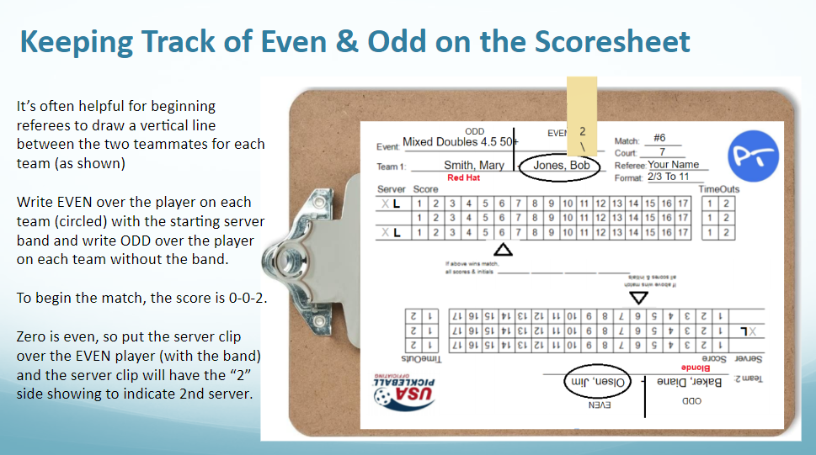

Slide 48
Final Pre-Play Procedure
Establish Position 2-6 Feet DIRECTLY BEHIND Net Post
Point Clipboard Clip Toward Serving Team
Server Clip Over Circled Starting Server with “\2” Facing You
Watch for potential illegal service motion (but no coaching)

Slide 49
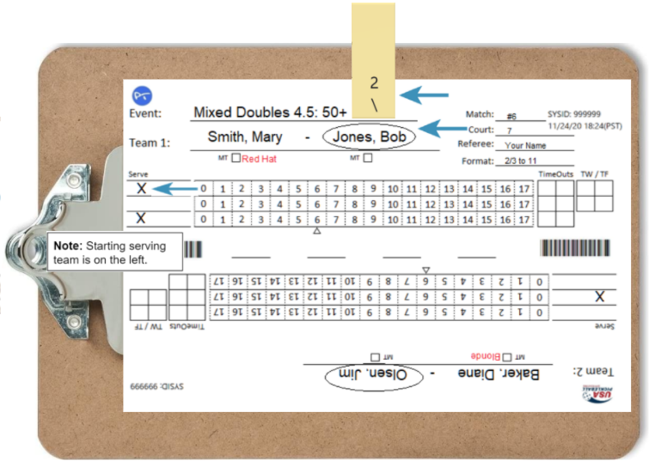

Clipboard Clip Toward Serving Team

Slide 50
Final Pre-Play Procedure (cont'd)
Confirm teams by name (Beginning of Match only)
Visually verify starting server ID & player positioning
Have serving team choose game ball and remove all other balls
Give 15 sec Warning

Slide 51
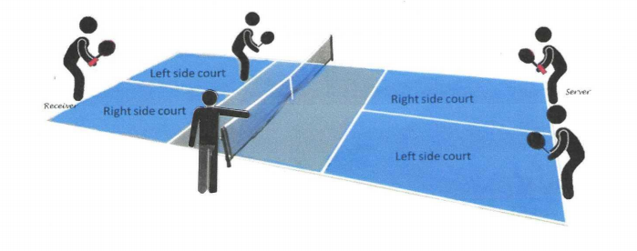
Final Pre-Play Procedure (cont'd)
Players in the even side of courts have server wristbands @ 0-0-2

Slide 52

Player Positions - Who Should be Where?
Score is 1-0-2 with starting server band - Hank (red shirt) on serving team and Caroline (black top) on receiving team
(Time stamp: 8:35 – 8:57)

Slide 53
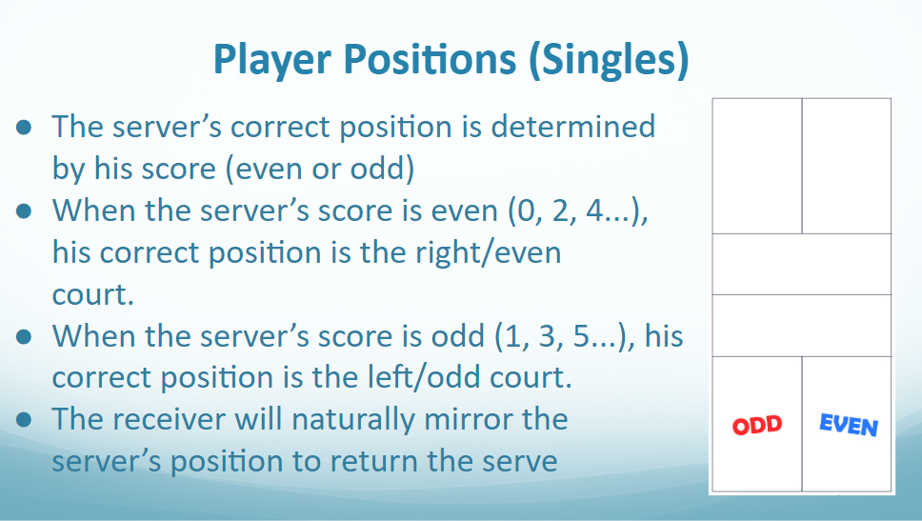

Slide 54

Break/Questions

Slide 55
Before Calling the Score (cont’d)
Mentally Confirm Correct Server & Receiver & They Are
In Their Correct Positions based on the score and server ID
Check the score, Say the Score
in your Head, & Drop the
Clipboard To Your Side or
Behind You
Do this BEFORE looking
up from the scoresheet, EVERY TIME!
Notes:
Let’s start with what might possibly the most important piece of advice that you will get. Every single time before you call the score, look at the scoresheet to confirm the score and player positions. Before you look up from the scoresheet, be certain that you know what you expect to see when you look up. In this example, you could describe the situation in your mind a couple of ways:
Band on the right is serving to band on the other team
Male on the right is serving to male on the other team
The person not wearing the red hat is serving from the right to the blonde person on the other team
Regardless of your specific choices on how to identify players, you need to have them identified in your head before you look up to confirm that you see what you expect to see.

Slide 56
Before Calling the Score (cont'd)
Look Up and Confirm What You “saw” in Your Head.
Confirm Readiness of Players
Announce Score (Clearly, Loudly & With Consistent Cadence)
Begin 10-Second Count – if ball is served (struck) before the start of the score being called, it is a replay. If ball is stuck after the start of the score being called and before the entire score is called, it is a fault.

Slide 57
Before Calling the Score (cont’d)
Confirm “Readiness” at Start of Game
Ball in hand of server
Check receiver & partner - Ready? or should be ready?
Look at server & partner - Ready? or should be ready?
Not Ready signals – can be given by either player
Raising paddle OR non-paddle hand above head
Turning back to the net
Notes:
Now you must confirm player readiness before you call the score. Starting in 2020, the rules were changed to state that any player can show a not ready signal, not just the server and receiver. Not ready signals include having your back to the net or having either hand raised. You should allow players a reasonable time to get ready.
However, if either team holds up their paddles to have an extended conversation trying to avoid the need to take a time out, you could reasonably call the score, since they should be ready.

Slide 58
Before Calling the Score (cont’d)
Confirm “Readiness” at the Start of Every Point
Ball in hand of server
Check receiver - Ready? or should be ready?
Look at server - Ready? or should be ready?
Not Ready signals – can be given by any player
Raising paddle or non-paddle hand above head
Turning back to the net

Slide 59
Before Calling the Score (cont’d)
Calling the score:
Announce Score
Clearly
Loudly and,
With Confidence
Begin 10-second count
Notes:
When you call the score, do it loudly, with a consistent cadence. Most pickleball venues have a lot of background noise. It is important that you make your calls loud enough for your players to hear you. If you have a player that tells you that they have a hearing impairment, you may want to increase your volume or add hand signals to give the player visual indications for when you have called the score.
It is also important that you use a consistent cadence when calling the score. Now that players are allowed to begin their service motion before you complete the score, they may pay attention to your cadence and time their serve so that it happens immediately after you complete the score. This is perfectly acceptable. If you accidentally change your cadence ( such as a cough during the call ) and that causes the player to strike the ball early, you should stop play, call a referee error, and recall the score.
Since the receiver is allowed to become not ready up until the time you begin calling the score, you might choose to be looking at the receiver when you begin, then transfer your focus to the server as you complete the score. So, the sequence could be: Check receiver readiness, check server readiness, look at receiver, begin calling the score, look at the server to watch their serve.
Once you call the score, begin your 10-second count in your head

Slide 60
After Calling the Score (cont'd)
After Score is Called, Server Has 10 Seconds To Serve
Receiver Ready Or Not
After the start of the score being called, "Not Ready“ signals are invalid, except for a Hinder
Players may request a Time-Out up until the time the ball is served (struck)
Players may ask questions regarding score, correct position/server/receiver before the ball is served (struck).
Notes:
The time immediately after call the score is one of the busiest for a referee. You have a lot of stuff the think about:
You are counting in your head
You are watching for service motion faults, volley serve or drop serve
You are watching for service foot faults.
So, the combination of focus and peripheral awareness is important.
If the server does not serve immediately, continue to count in your head. As you get close to the 10 second limit, the handbook says that you can begin to make ‘subtle’ hand motions to indicate that you are counting. Some referees will extend their hand out at 5 seconds, then move their hand up and down to count out 6, 7, 8, 9, and 10. If they still have not served by then, then they call a 10-second violation.

Slide 61
Watching the Serve - At Every Serve
Watch for Service Faults
Foot Faults – Baseline + Imaginary Extensions of Sidelines and Centerline
Illegal Serves
Visually Follow Ball to Receiving Court, watching for:
Short Serves that do not clear the NVZ (including the lines)

Slide 62
Legal Service Rules for “Volley” and “Drop” Serves
Server Must Have at Least One foot In Contact With The Court Behind The Baseline and Between the Outside of The Imaginary Extensions of the Sideline and Centerline.
Server’s Release of the Ball Must be Visible to the Referee and the Receiver. (A replay shall be called before the return of serve if the release is not visible)
The server can change between the Volley and Drop Serve at any time without declaring which serve will be used.
Server’s feet may NOT touch the court on or inside the baseline.

Slide 63
Legal Service Motion – “Volley Serve”:
Three Elements – at the point of contact the paddle the server must at the point of contact:
- Be moving their arm in an upward arc
- Keep the highest point of the paddle head
below the wrist break
- Contact the ball at or below their waist
The server must only use their non-paddle hand to release the ball for the purpose of serving
If the ball is visibly spun by the server, the part(s) of the hand contacting the ball MUST be BARE. “Only the skin can impart the spin”

Slide 64
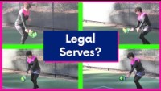
Legal Volley Serves
CJ Johnson – Better Pickleball - 2019

Slide 65
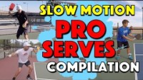
Legal Volley Serves
Tyson McGuffin & Ben Johns

Slide 66

Non-legal Volley Serve With Spin Before Contact
Zane Navratil – Next Gen Serve – 2021
(first introduced by Morgan Evans)

Slide 67
Legal Service Motion – “Drop Serve”
Server’s Release of the ball must:
Be dropped from one of their hands or off the server’s paddle face
Be dropped from any NATURAL (un-aided) height
When Dropped the ball must NOT:
Have any force applied to it
No Upward or Downward motion
No Spin Applied to Ball
After the Ball is Dropped:
The Ball May Bounce More Than Once and The Server May Catch and Re-drop the Ball.

Slide 68
Serving Motion– Replay or Fault?
As a referee, enforcing the service motion rules is not easy. At real-time speed it can be difficult to judge.
If a referee is not certain whether a serving violation has occurred but believes the service motion or spin is “marginal”, the referee may call a replay.
- “Stop Play. Questionable whether (state the issue). Re-serve. I will recall the score”
- NOTE: the same holds true for the release of the ball not being visible.
The replay must be called before the return of serve.
The referee shall call a fault if they are certain that one or more of the requirements of a legal serve (4.A.5.a through 4.A.5.f and 4.A.7.a through 4.A.7.c) are not met.
This replay option DOES NOT apply to foot faults on the serve.

Slide 69
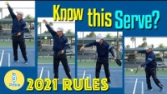
Legal Service Motion – “Drop Serve”
(Time stamp: 1:55 – 4:38)

Slide 70
Imparting Spin on the Serve

Slide 71
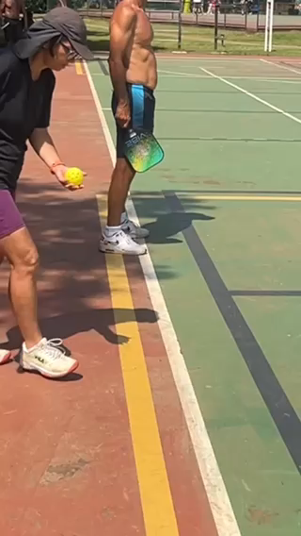
Imparting Spin on the Serve - Yes or No?

Slide 72
Player Readiness – Flow of Game
Following Dead Ball, Players are Expected to Move to Respective Positions without Delay
Allow Receiver Reasonable Time to Become Ready
Call Score When Receiver is Ready (or Should Be Ready) & Server is in Position with Ball in Hand
If Delaying for no apparent reason
Call Score When Receiver Should Be Ready and Begin 10-Second Count

Slide 73
Correct Server/Receiver/Position Questions
Any player may ask questions regarding whether they are the correct server/receiver
- “Am I the correct server/receiver? Give “Yes/No” reply
Any player may ask questions regarding their or their team’s position
- “Am I in the correct position?” Give “Yes/No” reply
Any player may ask “am I good” (which combines both of the previous questions).
- Give “Yes/No” reply. If “no“, identify any and all potential faults for these questions.

Slide 74
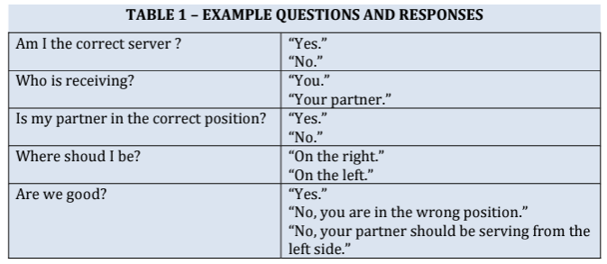
Correct Server/Receiver/Position Questions
Being specific in your answer is NOT considered coaching because it was provided in response to a player question

Slide 75
Correct Server/Receiver/Position Questions
Officiating Handbook – Section 5.A.4.b.(1)
“b. After the ball is hit to make the serve, if a player stops play to challenge
an incorrect server, receiver or position:
1) Correct Challenge: call a fault on the incorrect player (Rule 4.8.9).
However, if the players are out of sequence or position due to your
incorrect score call, replay the rally.”
2) Incorrect Challenge: If no player is incorrect or out of position
according to the correctly called score, call a fault against the player
who stopped play (Rule 7.1)

Slide 76
Score Questions
If asked before you call the score:
- Reply with : (e.g.) “You have 4 points”
- If asked for the “Complete Score” – step forward, raise arm and reply “You have 4, they have 2, and it is the 2nd server.”
- Step back into position and recall the score to begin the rally

Slide 77
Score Questions (cont’d)
If asked after the score is called but BEFORE the ball is hit to make the serve:
If the score was called correctly – acknowledge the correct score, announce that you will recall the score, recall the score when all players are ready
If the score was called incorrectly, announce “Correction”
Acknowledge the correct score and announce that you will recall the score. Allow players to adjust positions, if necessary and recall the score when all players are ready
If asked AFTER the ball is served but Before the return of serve:
- A player may stop play to correct an incorrect score. The really is replayed with the correct score and there is no fault on the player.
- If the score was originally called correctly, it is a fault on the player.

Slide 78
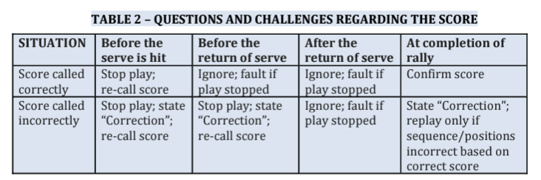
Score Questions (cont’d)
Officiating Handbook - Section 5.A
Key Situations and Violations: Serving and Receiving

Slide 79
Serve Timing
There is no penalty if the server serves the ball before the start of the score being called – allow the player to re-serve the ball after the complete score is called.
There is no penalty if the server starts their service motion before the complete score is called.
It is a fault if the server hits the ball before the last number of the score is called.
Any 10-second violation will result in a fault against the server/serving team.

Slide 80
Service Situations
Balls Hitting a Receiving Player
Any serve striking receiver or receiver’s partner before the ball lands
in the proper service court it is a point for the serving team.
(“Nasty Nelson” – from Timothy “The Puppet Master” Nelson)
Balls Hitting the Net on the Serve*
No longer a “Let” as long as the ball lands in the proper service court
and clears the NVZ line
(*Note: PPA still follows the old “let” rule. APP uses the new no-let rule)

Slide 81
During Play
At the end of every rally (immediately, loudly and confidently call:
“Point” or
“Second Serve/Second Server” or
“Side Out”
At the end of each rally, if you do not hear a line call or see a player’s “out” signal, do not prompt the player for a line call. Call the score assuming the ball was “in”.
Notes:
When you see a fault, call it immediately, loudly, and confidently.
When you call a fault, you should include enough information to explain the fault to the player. Examples include:
Service fault: Incorrect receiver
Service fault: You struck the ball before the score was completely called
Foot fault: Right foot (NVZ fault)
Foot fault: Right foot did not reestablish ( NVZ push off fault)
Follow the call with the appropriate result: Point, Second Serve, Side Out

Slide 82
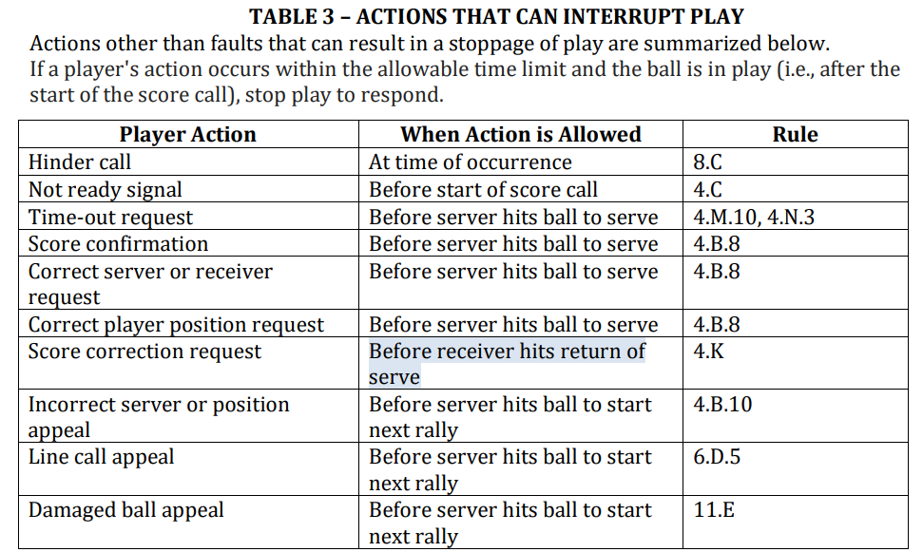
ACTIONS THAT CAN INTERRUPT PLAY
If player’s action occurs within the time limit and ball is in play (after the start of the score being called) stop play and respond
If a player stops play and asks for a score correction before the return of serve – correct an incorrect score and replay the rally OR call a fault on the player if the original score called was correct.

Slide 83
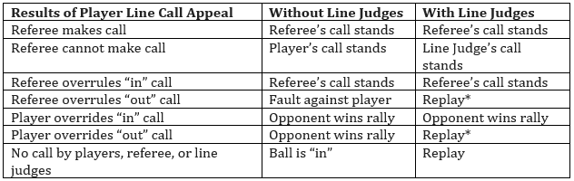
LINE CALL APPEAL ACTIONS
* Note: An officiating error occurs when an official’s “out” call is overruled or overridden,
resulting in the opponent being given an opportunity to replay the rally.

Slide 84
During Play (cont'd)
When A Volley Is Hit:
Focus on No Volley Zone (NVZ) for fault until player’s momentum is under control
Do Not follow flight of volleyed ball
Watching The NVZ Is Primary Your Responsibility
Keep your head stationary – watch with your eyes
Once ball bounces switch your eyes to the other NVZ line until next bounce or volley
Notes:
Watching for NVZ faults is one of the most important functions of a referee. Train yourself to stay focused.
Keep focus on the player most likely to fault, even if play has moved on from them.
Keep your head still. Don’t move it from side to side. You can refocus faster and more accurately by just moving your eyes.
Don’t follow the ball. Focus on the feet.
If it takes you a second to be 100% sure about a fault, that is OK. Call the fault, even it a couple of additional hits have occurred.

Slide 85

Watching the NVZ (referee focus)
NVZ Faults - Pickleball Channel 411
Rusty Howes, Jennifer Lucore & Alex Hamner
(time stamp: from start then stop at 4:25)

Slide 86
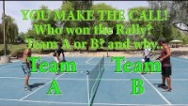
Watching the NVZ (referee focus)
You Make the Call – Who Wins the Rally?
Team A or B? And Why?

Slide 87
More NVZ Tips
Call NVZ faults immediately
When only 1 team is at the net, keep focus on them
When players attempt an Erne, move back if possible, but maintain focus on their feet
Use your peripheral vision to look for plane of the net faults.

Slide 88
More NVZ Tips
Keep you focus on a player’s feet for an extra second after a close no-call (aka: shoe shopping)(genie shoes)
Don’t be ashamed if you didn’t see a ball landing away from the NVZ. If you didn’t see it, say “By rule the call stands” If you realize after the fact that a NVZ fault occurred a hit or two later – call the fault anyway.
Don’t be ashamed if you call a foot fault on a bounced ball – it’s easy to do! Announce “correction” and replay the point.
Notes:
Remember that dealing with line call appeals is much lower on your priority list than calling NVZ faults. If you get a line call appeal that you didn’t see because you were doing your NVZ job, say that without
apology. ‘Ref, did you see that?’ ‘No, didn’t clearly see it”

Slide 89
More NVZ Tips – Momentum
If a player hits a volley and the ball hits their opponent before the player’s momentum carries the player into the NVZ, is it a fault on the player? YES
If a player hits a volley and the ball hits inbounds on the court, then hits the back fence clearly before the player’s momentum carries them into the NVZ, is it a fault on the player? YES
If a player hits a hard volley that is returned by their opponent to the player’s partner and the player’s partner hits a clear winner between their opponents, before the first player’s momentum from their original hard volley shot causes them to step in the NVZ, is it a fault on the payer? YES
An opponent’s serve barely clears the NVZ line. The receiving player runs to return this short (but legal) serve and the receiving player’s momentum carries them into the NVZ, if it a fault against the receiving player? NO

Slide 90
Moving Clip & Marking Side Out
Move Server Clip at:
Every Server Change
Every Side Out
Mark Every Side Out As It Occurs:
Vertical Line To Right of Last Point Scored
(including 0)
Notes:
When you change from First to Second Server, you remove the clip, flip it, and place it over the name of the other team member. You do not flip the clipboard.

Slide 91
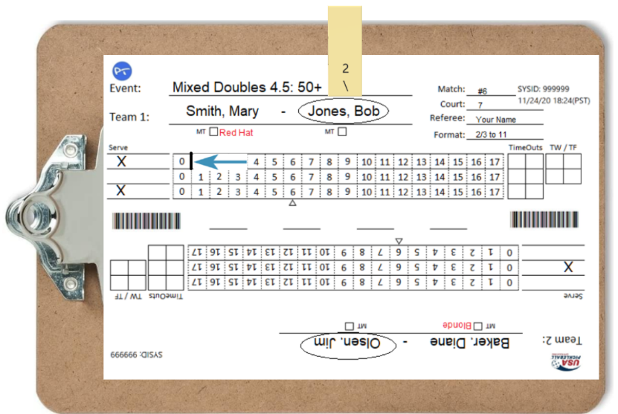
When Team Fails To Score On First Possession Of Game, Mark Vertical Line between “0 & 1”
Notes:
The new scoresheet format now has a 0 box. If the team doesn’t score on their first possession, place the side out mark to the right of the 0. You may still encounter the old scoresheet, which doesn’t have a 0 box. In that case, place the side out mark to the left of the 1 box.
If you are in the middle of the game and the team did not score at all on the current side out, you will already have a side out mark to right of their current score. You do not need to make another mark. However, you may find that you muscle memory causes you to trace over the existing mark. That is certainly OK.

Slide 92
Marking Points on the Scoresheet
Record Every Rally Result As It Occurs
Use Alternating Diagonals In Score Box Based On Server:
1st Server Points = Forward Slash
Upper Right To Lower Left (/) (per numbered clip)
2nd Server Points = Backward slash
Upper Left To Lower Right (\) (per numbered clip)
Notes:
Once a rally is over, do your paperwork first. It is easy to be distracted by questions, errant balls, or hinders. By the time you deal with the distraction, you may have forgotten the result of the rally.

Slide 93

USA Pickleball Referee & Line Judge Resources

Slide 94
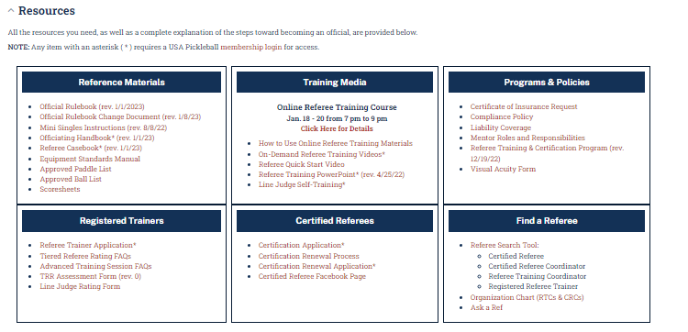
USA Pickleball Referee & Line Judge Resources

Slide 95
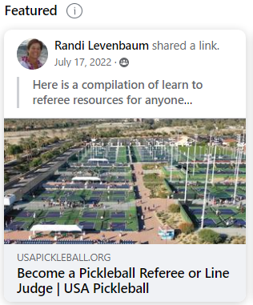
USA Pickleball Referee & Line Judge Resources
Additional online resources for referees/referees in training:
Facebook Groups:
Pickleball Referees in Training
Ask the (Pickleball) Refs
Pickleball Referee Tips
Growing Compilation of Resources
-Pickleball Referees in Training
Weekly/Regular Zoom Calls
CR Nancy Kaplan’s weekly referee Zoom calls (open to all) – Mondays 4:30pm PT
CR Bob Swisshelm’s (almost) weekly referee Zoom calls – Tuesdays 5:00pm PT
CR Melody Woodsum’s “In the Ref Tent” monthly Zoom series – Wednesdays 5:00pm PT
PRA - Professional Referee Association Video Series via YouTube
Search “PRA Referee Videos”

Slide 96
End of Day 1 -Questions

Slide 97
Officiating Pickleball
2023
Day 2
“RECORD REMINDER”
© 2023 USA Pickleball

Slide 98
General Course Outline – Day 2
(Section References correspond the USAP Officiating Handbook)
Day 2:
Follow-up from Day 1 & Quiz (slides 97 – 103)
Section 4: Refereeing a Match (Doubles Play) (slides 103 – 141)
Section 5: Key Situations and Rules Violations (slides 142 – 185)
End of Day 2 – Resources & Questions (slides 186 - 187)

Slide 99
Follow Up from Day 1
Email last night with Chat questions answered
Upcoming revisions to Officiating Handbook and Casebook – what to do between now and 1/31/23 projected posting to USAP website
Imparting spin on the serve
Email this afternoon with homework for tonight before tomorrow’s class – disregard the first one without the attachment but with a useful kitchen remodel video!
Catch up on last set of slides from last night – Standard Time-Out Procedures
BUT FIRST A QUIZ

Slide 100
Quiz – Day One Topics
Until what Point in Time can a player call a Time Out, without incurring a penalty?
a. Before the Ref starts calling the score
b. Before the Ref completes calling the score
c. Before the server hits the ball to make the serve
d. Before the 3rd shot return
2. True or False – You change sides at 6 points in the 3rd game of matches that are best of 3 to 11 by 2 format.
3. A ball is declared DEAD when;
a. The Ref calls a Fault
b. The Ball bounces a 2nd time
c. The ball hits the playing surface & no player can reach it.
d. Both a & b
e. Both b & c
True or False – The Playing Surface is the area outside the court boundary (white lines) at both ends of the players’ courts.

Slide 101
Quiz – Day One Topics
True or False – The Referee always has to wait for a player to ask about a line call before they can rule on it.
True or False – Line calls are an important part of the Referees job, and they should always try to follow the flight of the ball.
True or False - When the opposing team makes a side out, the Starting Server (player with the ID) will always serve first.
True or False – A receiver who has a foot extending beyond the sideline when they return the serve, will be deemed to have committed a fault.
True or False – A player will have committed a fault if they serve the ball prior to the Referee calling the score.
At what Point in Time during a Time-out do you check that your Line Judges are ready to commence play?

Slide 102
Quiz Answer Key – Day One Topics
Until what Point in Time can a player call a Time Out, without incurring a penalty?
a. Before the Ref starts calling the score
b. Before the Ref completes calling the score
c. Before the server hits the ball to make the serve
d. Before the 3rd shot return
2. True or False – You change sides at 6 points in the 3rd game of matches that are best of 3 to 11 by 2 format.
3. A ball is declared DEAD when;
a. The Ref calls a Fault
b. The Ball bounces a 2nd time
c. The ball hits the playing surface & no player can reach it.
d. Both a & b
e. Both b & c
True or False – The Playing Surface is the area outside the court boundary (white lines) at both ends of the players’ courts.

Slide 103
Quiz – Day One Topics
True or False – The Referee always has to wait for a player to ask about a line call before they can rule on it.
True or False – Line calls are an important part of the Referees job, and they should always try to follow the flight of the ball.
True or False - When the opposing team makes a side out, the Starting Server (player with the ID) will always serve first.
True or False – A receiver who has a foot extending beyond the sideline when they return the serve, will be deemed to have committed a fault.
True or False – A player will have committed a fault if they serve the ball prior to the Referee calling the score.
At what Point in Time during a Time-out do you check that your Line Judges are ready to commence play? With 15 seconds remaining.

Slide 104
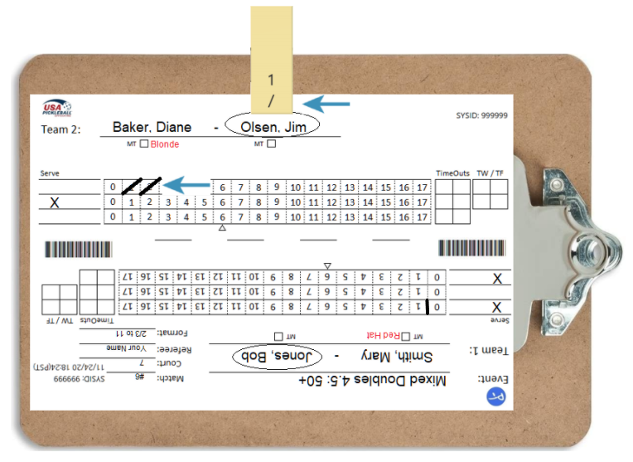
First Server Points Marked Upper Right To Lower Left (/)
Notes:
Use the slash shown by the server clip to mark each point. In this example, we are on first server, so we’d use a forward slash.

Slide 105
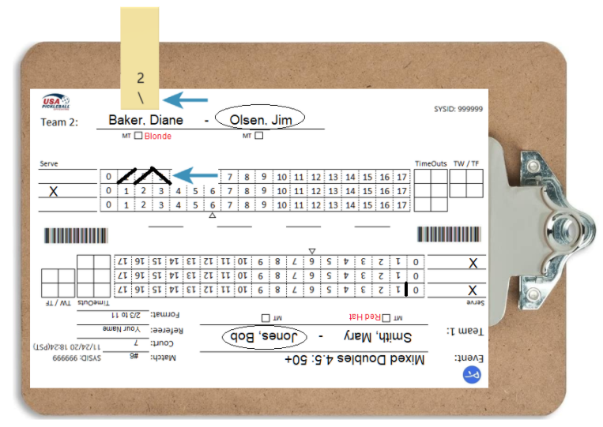
At Second Server Reverse Clip
Notes:
In this example, we are on the second server, so we’d mark a point with a backward slash.

Slide 106
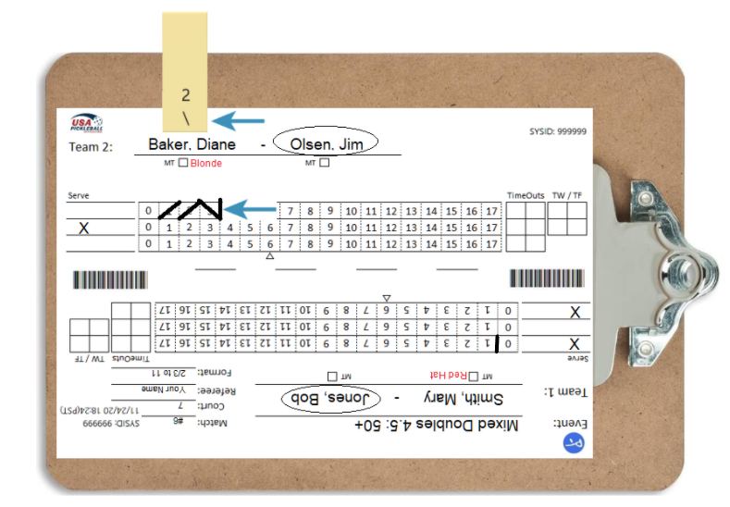
Side Out Recorded Using Vertical Line (|) To Right of Score
Notes:
When there is a side out, you mark the side out on the scoresheet before flipping the clipboard. You place the mark to the right of the team’s current score.

Slide 107
Managing the Clipboard At Side Out
After Marking Side Out Line:
Rotate clipboard so board clip is pointing toward the new serving team
Reposition server clip to correct server (based on odd/even score) with "1/” facing you
Be As Efficient As Possible
Notes:
After marking each side out mark, you need to flip it so that the new serving team’s information is on the top. You also need to reposition the server clip over the correct server, based on the score of the serving team. There are a couple of efficient ways to do this. Here is a video clip that shows the side out process. Note that they remove the clip first.

Slide 108

Marking the Scoresheet

Slide 109
Standard Time-Out Procedure
When Player Calls Time-Out:
Standard Script:
Announce “Time-out, receiving/serving team, 6-8-2, one minute”
Activate Timing Device
Move To Center Court to complete recording the time-out and to Avoid Interaction With Either Team and spectators
Time-out called by a player just before the end change:
If no portion of a time-out has been used, do not record it and the team gets to retain the time-out for later use.

Slide 110
Standard Time-Out Procedure
Time Out Script at the end of the time-out:
“15 seconds”
“Servers you have _X_ time outs remaining; receivers you have _X_.”
“Time-In 6-8-2.”

Slide 111
Time-Out Procedures (cont’d)
Mark The Game Score In The Appropriate Time-Out Box (Do NOT rotate the clipboard. Always keep the serving team’s name at the top of the clipboard)
Separate Team Scores Using Same Diagonal Slash As On Server Clip:
1st Server = Forward Slash (/)
2nd Server = Backward slash (\)

Slide 112
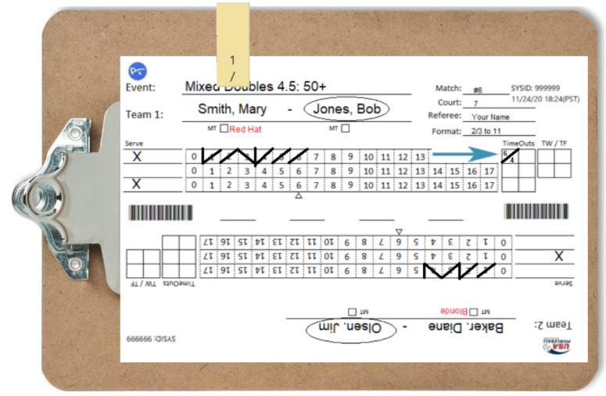
Time-Out Example
Time-Out Called By The Serving Team At 6-4-1

Slide 113
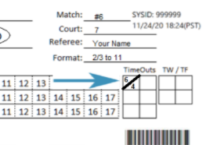
Time Out Called by SERVING Team
Draw Diagonal Mark based on Score
place numbers above & below Serving Team’s Score on top

Slide 114
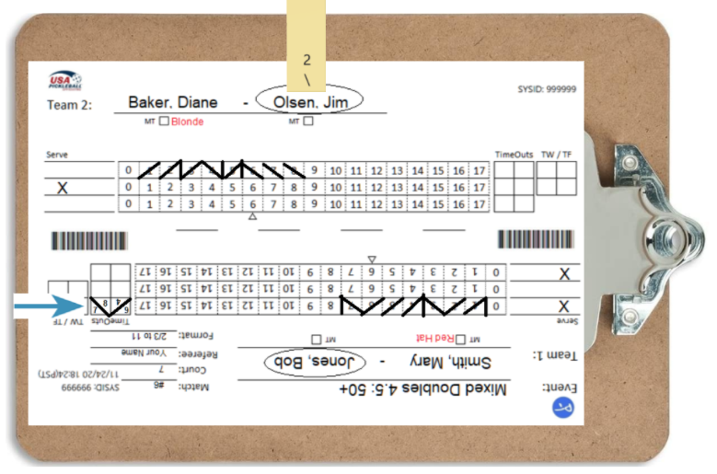
Time Out Called by RECEIVING Team

Slide 115
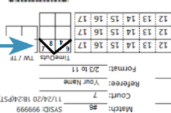
Time Out Called by RECEIVING Team

Slide 116
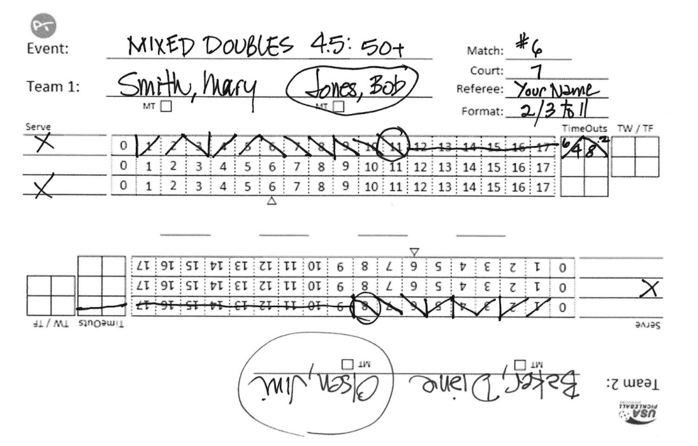
Standard Time-Out Procedure - Double Time-Out Between Games
End of Game 1 Scorecard

Slide 117
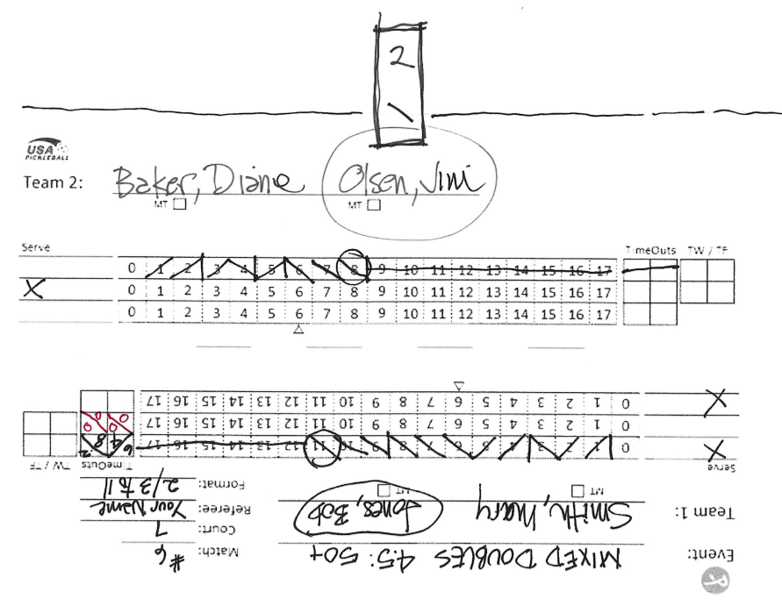
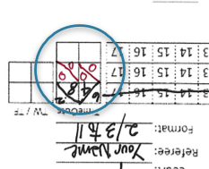
Standard Time-Out Procedure - Double Time-Out Between Games
Start of Game 2 Scorecard

Slide 118
Time-Out Procedures (cont’d)
Advise each team of remaining time-outs (usually just before restarting game)
If a player leaves the court with paddle, re-inspect before play resumes
Watch players - if they appear to be resuming position early, move toward your post and check readiness.

Slide 119
Time-Out Procedures (cont’d)
Ask if ready to proceed and then skip the 15 second notification
If Using Line Judges or a second referee - check readiness
If players are not ready early, advise when there are 15 seconds remaining
If players are not ready early, at 1 minute mark, announce “time-in” and call the score

Slide 120

Time-Out Procedures

Slide 121
Time-Out Reminder
Time-Out Can Be Called until the Paddle strikes the Ball to initiate the Serve
Time-Outs Can Be Requested before the start of the 2nd or 3rd games (e.g., between games)

Slide 122
Time-Out Reminder (cont'd)
Players may request consecutive Time-Outs between rallies or between games.
A Team May Call All of Its Time-Outs at Once Without Needing To Be Present On The Court
If Player(s) return prior to one minute, 2nd Time-Out still available
The “15-second” warning is not precise but is a head’s up that play will resume in ABOUT 15 seconds

Slide 123
Standard Time-Out Procedure

Slide 124
End of Game
Announce “Point, Game, (Final Game Score)” & “Change Ends, 2 Minutes”
Start Timer
Collect & Hold Game Ball
Move To Center Court & Prepare Scoresheet For Next Game
Draw Line Through Unused Points and Unused Time-Out Boxes if Additional Game(s) is to be Played
Lightly Shade or Circle Final Scores

Slide 125
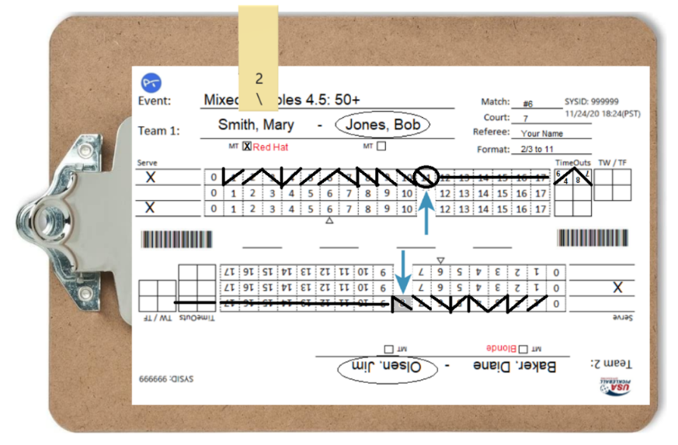
Circle Or Lightly Shade The Box Containing The Final Point Scored By Each Team

Slide 126
Between Games
Rotate Clipboard So Board Clip Is Facing Serving Team
Rotate Scoresheet Accordingly
Place Server Clip with "\2" Above Starting Server

Slide 127
Between Games (cont'd)
If Third Game, Remind Players of Upcoming Change of Ends Halfway Through
Notify Players when 15 Seconds Remain and Return to Referee Position
If Line Judges or a second referee are used, Check Readiness
Return Ball to Serving Team’s End of Court
At the End of 2 Minutes, Call “Game #”, “Time In,” and “0-0-2”
Start The 10-Second Count

Slide 128
Between Games (cont'd)
If Third Game, Remind Players of Upcoming Change of Ends Halfway Through
Notify Players when 15 Seconds Remain and Return to Referee Position
If Line Judges or a second referee are used, Check Readiness
Return Ball to Serving Team’s End of Court
At the End of 2 Minutes, Call “Game #”, “Time In,” and “0-0-2”
Start The 10-Second Count

Slide 129
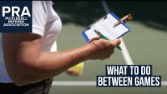
Between Games (cont'd)

Slide 130
End Change - 6, 8, 11 Points
Instruct teams to change ends
Announce score, and 1 minute
Start 1-minute count on timer
Move to center of the court
The Change of Ends is an End Change Time-out; Coaching IS Allowed!
If you forget to change ends at 6/8/11 points, switch ends when you realize it – does not change score.

Slide 131
End Change - 6, 8, 11 Points
End Change Script:
“Time out, change ends. You have 1 minute. The score is ___-___-___.”
Walk to center and complete your paperwork
“15 seconds”
“Time-in ___-___-___”
Note: in the 3rd game of a 2 out of 3 match, no end change occurs if the first game was forfeited due to last arrival

Slide 132
End Change - 6, 8, 11 Points (cont'd)
Before removing server clip, mark “1” or “2” on the scoresheet next to current server's name
(Based On Server Clip Number)
Remove server clip
Rotate scoresheet on clipboard
Rotate clipboard so that clipboard clip is now facing serving team (serving team names will now be right side up)
Replace server clip over server using “1/” or “\2” above server’s name

Slide 133
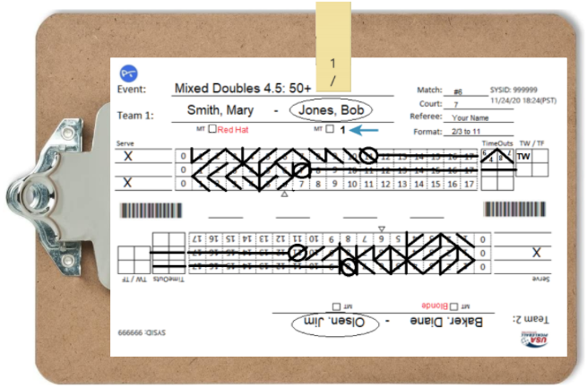
End Change Markings

Slide 134
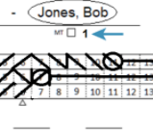
End Change Markings

Slide 135
End Change - 6, 8, 11-Point (cont’d)
Once the end change point has been scored, a technical foul resulting in the loss of a point for the serving team shall have no impact on the completion of the end change.
Notify when 15 Seconds Remaining
If Line Judges are used, Check Readiness
At 1 Minute Mark, Announce “Time IN” and Call The Score
Start the 10-Second Count

Slide 136

End Change

Slide 137
At Completion Of Match
Announce: “Point, Game, Match, 11-5 and the winning player’s last names”
Thank Line Judges & dismiss (if used)
Orient scoresheet with winning team names positioned right-side up
Circle winning team names and write “WINNERS” inside the circle

Slide 138
At Completion Of Match (cont’d)
Do NOT draw line through last game unused points or time-out boxes
Record scores in middle of scoresheet if there are lines or a space; if not, record scores next to winning team’s names
Record Game Scores in Order Played with Winning Team’s Score(s) Written First (e.g., 11-8, 7-11, 11-4)

Slide 139
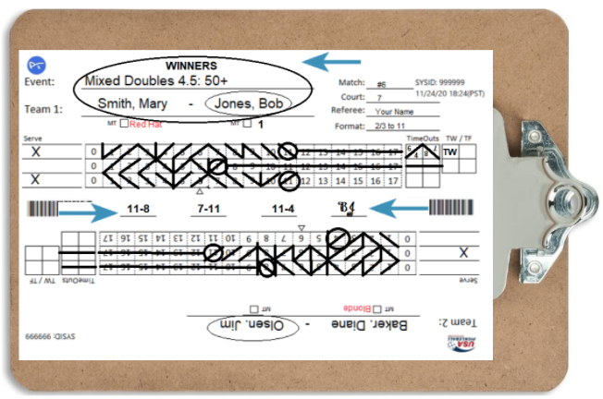
End of Match Markings
Completed Score Sheet

Slide 140
At Completion Of Match (cont’d)
Have one of the winning players confirm score(s) and initial next to the scores VERIFY CORRECTNESS!
Orient the scoresheet on the clipboard so that the winner’s names are on the top and the clipboard clip is on the left side.
Promptly return scoresheet to referee desk

Slide 141
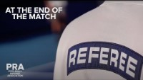
End of Match

Slide 142
Server/Receiver Faults (reminders)
Correct Server/Receiver depends on score and who is wearing the Starting Server Id.
Even Score = Player with Starting Server ID in right (even) court.
Odd Score = Player with Starting Server ID in left (odd) court.

Slide 143
Server Out Of Position Or Wrong Server
After the ball has been served
Announce “service fault”
State “2nd server” or “side out”
Explain fault as necessary

Slide 144
Wrong Receiver
After the ball has been hit by the returner, announce, “receiver fault”
State “point”
Explain fault as necessary

Slide 145
Serving Prior to Complete Score Called
Call “service fault” followed by “second server” or “side out”
No fault if server serves (strikes) the ball before the start of the score being called – replay
No fault if serving motion is started while the score is being called!
Server Foot Faults
Call “foot fault” immediately upon violation, followed by “second server” or “side out.”
Do Not Elaborate or Debate

Slide 146
Break/Questions

Slide 147
Stacking
Concentrate Only On Proper Server and Receiver Based On:
Score
Starting Server Identification
Server Clip—First (1/) Second (2\)
Ignore Partner Positioning

Slide 148
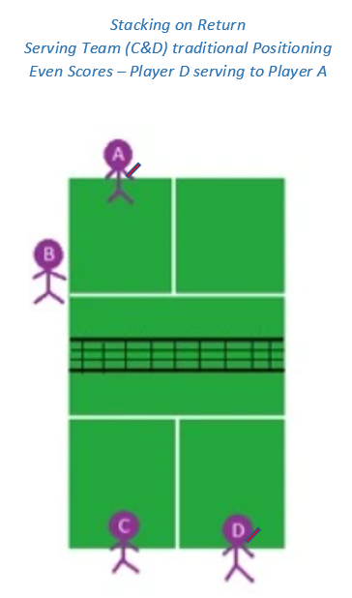
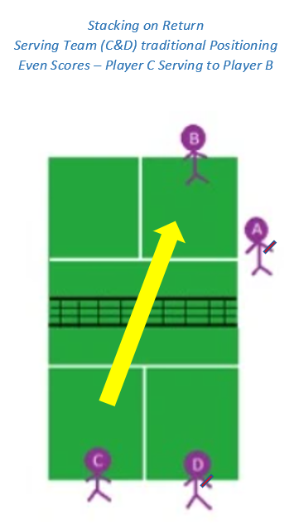
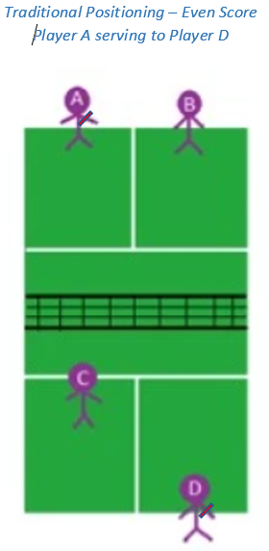
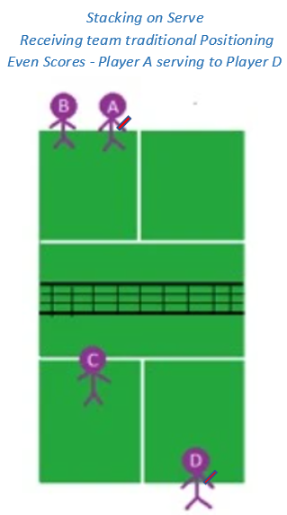
Stacking
(Players A and D are their team’s first servers ( ) – both teams have an even score)

Slide 149
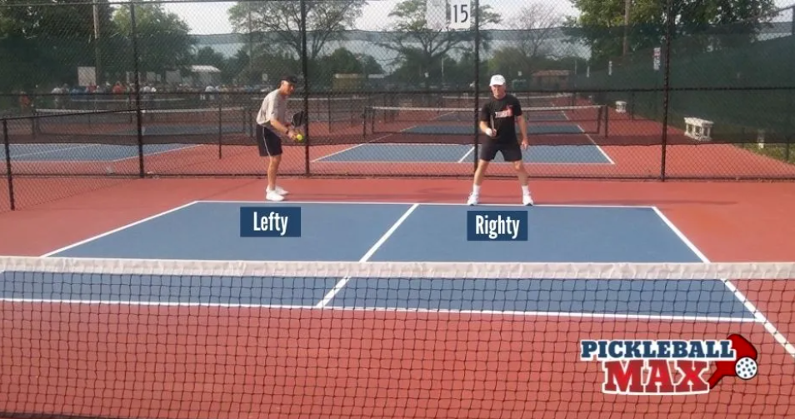
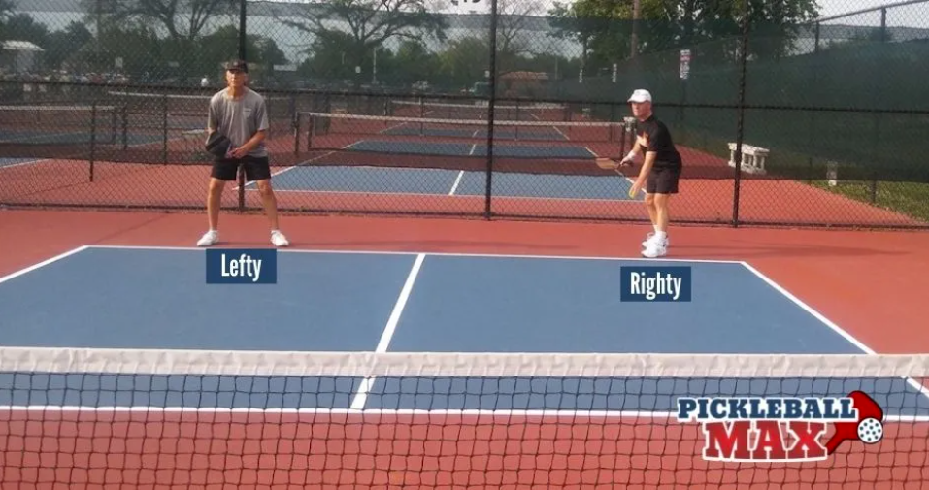
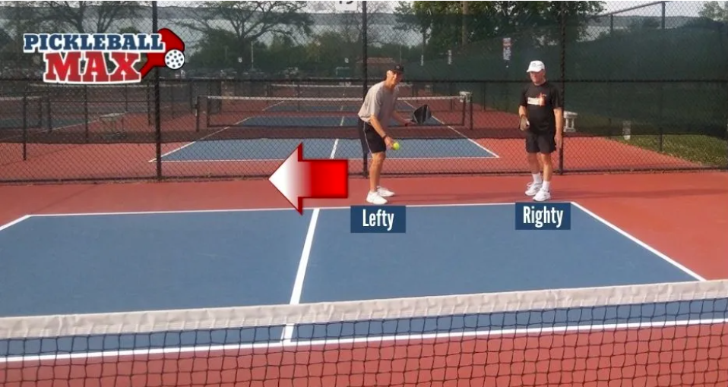
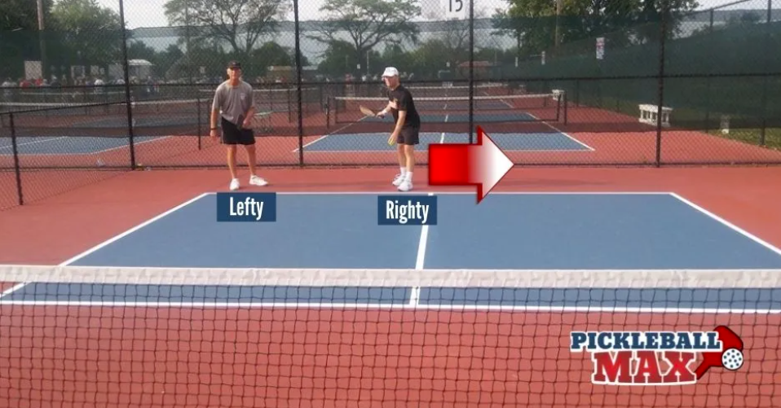
Stacking – Serving Team

Slide 150




Stacking – Receiving Team

Slide 151

Switching – Receiving Team

Slide 152
NVZ Violations
Your Primary Responsibility
Prior to, During or Following a Volley
Anything the Player is Wearing, Carrying or is Contacting, touches the NVZ
Watch Momentum Closely
Call Fault Immediately – if you saw a violation but didn’t call it and the rally continues, still call it once you realize it.

Slide 153
NVZ Shots
Jumping Across NVZ – Player:
Cannot touch NVZ prior to or after landing, if ball is volleyed

Slide 154
NO CONTACT WITH NVZ BEFORE VOLLEYING
NVZ
NE
T
L
R
LEGAL

Slide 155
NVZ Shots (cont'd)
Crossing Through NVZ - player’s feet:
Both feet must contact playing surface outside NVZ before ball can be legally
volleyed

Slide 156
VOLLEYING BALL BEFORE BOTH FEET HAVE MADE CONTACT OUTSIDE NVZ
NVZ
NE
T
L
R
FAULT

Slide 157
VOLLEYING BALL AFTER BOTH FEET HAVE MADE CONTACT OUTSIDE NVZ
NVZ
NE
T
L
R
X
LEGAL

Slide 158

NVZ Shots (cont'd) Jumping Across and Crossing Through NVZ
Pickleball 411 – Crossing the NVZ for an Erne (Alex Hamner)

Slide 159

Watching the NVZ – Referee Focus
Jay Devilliers

Slide 160
Pushing Off From NVZ
After Being in the NVZ:
Player cannot legally volley the ball until both feet have contacted the playing surface completely outside the NVZ

Slide 161
VOLLEYING BALL BEFORE BOTH FEET HAVE MADE CONTACT OUTSIDE NVZ
NVZ
LEFT FOOT FROM NVZ IN AIR
NOT PLANTED
L
R
NE
T
FAULT

Slide 162
VOLLEYING BALL AFTER BOTH FEET HAVE MADE CONTACT OUTSIDE NVZ
NVZ
LEFT FOOT (X) PLANTED OUTSIDE NVZ BEFORE VOLLEYING BALL
X
L
R
NE
T
LEGAL

Slide 163

Pushing Off From NVZ
Dave Weinbach/Sarah Ansboury vs
Kyle Yates/Christine McGraft
Dave Weinbach (red hat/yellow-green shirt)
Fault or No Fault?
(time stamp: from start then stop @ 0:45)

Slide 164

Re-Establishing Position Outside the NVZ
- After a dink and before a Volley
You Make the Call – NVZ – Fault or No Fault?
(time stamp – stop at 1:05)

Slide 165
Crossing Plane Of Net
Legal
On the follow through of hit (e.g. “Erne”– Erne Perry) as long as the contact occurred on the hitter’s side of the net
When a bounced ball spins back and crosses over the net, the player may then cross the net plane to contact the ball

Slide 166

Crossing the Plane of the Net
Sarah Ansboury – The Erne
(Time stamp: from start then at stop 1:11)

Slide 167

Crossing the Plane of the Net (Wind-aided/Erne)
You Make the Call – Fault or No Fault?
(time stamp: from start then stop at 0:23)

Slide 168
Crossing Plane Of Net
Is NOT Legal when:
Attempted hit misses the ball
Paddle, non-paddle hand, Clothing, etc., extend past net or net post
Foot extends beneath net onto opponent’s court
Player Can Never Legally Touch Net/Post or Opponent’s Court Surface While the Ball is in Play!

Slide 169

You Make the Call
You Make the Call – Dead ball/Replay/Live Ball/Fault? (and why?)

Slide 170
Portable Net Rules
Ball strikes horizontal bar or center base before going over the net = Fault
Ball goes over the net and hits center base, horizontal bar or gets caught before or after bouncing = Replay
Permanent Net – if pooling/draping net on the court affects the ball in the referee’s opinion – it’s a replay

Slide 171

Portable Net Rules
You Make the Call – Dead ball/Replay/Live Ball?
(Time stamp: from start then stop at 0:25)

Slide 172
Referee Mistakes (“Corrections”):
Called Wrong Score Before the Ball is Served –
Call “Time” Announce “Correction”, Re-Call
Correct Score
Realized the Wrong Score was Called After the
Ball is Served but before the return of serve- call “Time” to
stop play, announce “Correction” and Re-call the correct score.
Realized the Wrong Score was Called After the Ball is Served but after the return of serve - allow the rally to continue and correct any error after the rally.
Called NVZ Foot Fault On Bounced Ball - Stop
Play Immediately, Announce “Correction” &
Replay

Slide 173
Player Readiness – Flow of the Game
Following a dead ball, players are expected to move to their respective position without unnecessary delay
Allow the server/receiver reasonable time to become ready – i.e. returning from recovering a dead ball
If the server/receiver is delaying for no apparent reason (i.e. talking with partner)
- Call the score when the server/receiver is ready (or should be
ready) and begin the 10-second count.

Slide 174

Player Readiness Jan/Feb 2022 Pickleball Magazine

Slide 175
Medical Time-Out (MTO)
Play Continues to End of Rally – do not stop ongoing rally
If Player is Accidentally Injured, or Requests a Medical Time-Out, Announce "Medical Time-Out” & Give Score.
If Player doesn’t ask for a MT but the referee is concerned that a player is in distress, referee may call a RTO and request an assessment for the player by Medical Staff – MTO is NOT assessed against the player)
One 15-Minute or Less per Player per Match
Summon Medical Personnel (or Tournament Director) to Assess Validity of Request
Start 15-Minute Timer upon Their Arrival

Slide 176
Medical Time-Out (MTO)
Summon Medical Personnel (or Tournament Director) to Assess Validity of Request
Start 15-Minute Timer upon Their Arrival
A player may rescind the request for a MTO if they do so before the Medical Personnel/TD arrive.
If the injured player is taken away from the court for treatment, go with them and pause the timer so the player isn’t penalized for “travel” time. Resume your timer upon arrival
at the treatment location.

Slide 177
Medical Time-Out (cont'd)
If Injury is Assessed to Be Valid
Remind All Players - Once Injured Player is Ready, Play will Resume
Bleeding must be treated
Blood on Court Cleaned Prior to Resuming Play (Referee T/O)
Place an “X” in the “MT” box under Player’s Name & Pertinent info on back of Scoresheet (Do NOT remove Server Clip)

Slide 178

Medical Time-Out Scoresheet Marking

Slide 179
Medical Time-Out (cont'd)
If Injury is Assessed to Be Invalid
Charge a Standard Time-Out Against Player/Team
Issue a Technical Warning Against Player/Team
If no standard Time-Outs remain, a Technical Foul will be assessed
Medical Time-Out is no longer Available for that Player for remainder of Match

Slide 180
Medical Time-Out (MT) (cont'd)
If the injured player is able to resume play to continue before 15 minutes is over:
give 15-second warning
check line judge and player readiness
announce “time-in”
call the score
If the injured player is not able to resume play within 15 minutes, call a match “Retirement” in favor of the opponent.

Slide 181
Medical Time-Out (MT) (cont'd)
If player has already used their MT and later in the game/match, the referee feels another medical assessment is necessary for player safety, the referee can call a referee time-out and have the player assessed again. If medical team says player is okay to play, then play continues immediately. If not okay to play, then the result is a “Retirement”.
Note: A player may rescind the request for a MTO before the medical personnel/TD arrives.

Slide 182
Bleeding And/Or Blood On Court
Do not stop ongoing rally
Bleeding/Blood must be stopped/cleaned up before play resumes
Referee Time-Out (Not Recorded on Scoresheet)

Slide 183
Hydration Breaks
No longer permitted nor identified as such
Okay for players to grab a quick drink when needed between rallies (usually when someone is retrieving the ball) like they do when they towel off
No announcement or stoppage of play.
Be alert and call score to resume play after allowing a reasonable time according to the conditions.

Slide 184
Referee Time-Outs (RTO)
Used to address extenuating circumstances (active bleeding, potential medical situation, etc.) – no TO/MT will be charged to the player(s) for a RTO.
Allow rally to complete, then stop play
Call a referee time-out if no player calls a time-out
Announce the reason for the time-out and the score
Collect the ball if not placed on court under a player’s paddle
No maximum number of RTOs and No time limit
No scoresheet notations required
When situation is resolved, give 15 second warning, announce “time in” and call the score.

Slide 185
Equipment Time-Out
At Referee's Discretion if necessary for fair and safe continuation of play
Reasonable duration to correct the issue
No Limit On Number
Examples of valid reasons: broken paddle, broken shoestring, ripped shorts, dislodged contact lens, etc.
When situation is remedied, resume play by giving a 15-second warning, followed by “time in” and call the score

Slide 186
2023 USAP Officiating Handbook
Key Appendices
Appendix B – Penalties for Unsportsmanlike Conduct & Inappropriate Behavior
Appendix C – Standardized Calls & Announcements
Appendix D – Sample Pre-Match Briefings

Slide 187
End of Day 2 -Questions

Slide 188
Officiating Pickleball
2023
Day 3
© 2023 USA Pickleball

Slide 189
General Course Outline – Day 3
(Section References correspond the USAP Officiating Handbook)
Day 3:
Follow-up from Day 2 (slides 188 - 198
Section 5: Key Situations and Rules Violations (slides 198 – 211)
Section 6: Player Behavior and Remedies (slides 212 – 245)
Section 7: Dual Referee Option and New Sanctioning Formats (slides 246 – 250)
Section 8: Medal Matches with Line Judges (slides 251 – 271)
End of Day 3 – Conclusion, Next Steps & Questions (slides 272 – 277)

Slide 190

Updates from Day 2

Slide 191

Updates from Day 2

Slide 192

Updates from Day 2

Slide 193

Updates from Day 2

Slide 194

Updates from Day 2

Slide 195

Updates from Day 2

Slide 196

Updates from Day 2

Slide 197

Updates from Day 2

Slide 198

Stopping Play

Slide 199
Questioned Calls/Rulings
Call Players To Net To Discuss
Ignore Spectator Input
Consult Line Judges, when in use
When Requested or Necessary to Resolve Dispute, Summon Head Referee or TD

Slide 200
Questioned Calls/Rulings (cont’d)
If Head Referee or Tournament Director is called:
If Referee’s Ruling is Correct – for the Disputing Team:
- Charge a Standard Time-Out Against Player/Team
- Issue a Technical Warning (TW) Against Player/Team
- If no standard Time-Outs remain, a Technical Foul (TF)
will be assessed
If Referee’s Ruling is incorrect – call “Correction” and replay the point.

Slide 201
Balls- Broken, Cracked, Degraded or Soft/Paddle
Broken/Cracked Ball:
Play continues to completion of rally
Referee determines if ball affected outcome
Replay possible at referee’s discretion only
Fault if player stops play
Degraded/Soft Ball:
Play continues to completion of rally
Fault if player stops play
If all players agree that the ball is degraded or soft, the ball will
be replaced – NO replay of the prior rally

Slide 202
Appealed Line Calls
Players are NOT required to make a line call before appealing to the
referee to make the call (Rule 6.D.3)
ONLY when appealed, make the call If you had a good angle & without a doubt clearly saw the ball “In” or “Out“.
Note: Exception when a Line Judge’s view was blocked you may make the call
immediately and without an appeal.
If you clearly saw it, say, “The ball was in/out” and avoid using, “I think the ball was
in/out”.
If you didn’t clearly see it, say “By rule, the call stands”.
Do Not overrule a line call unless you are absolutely certain the player’s call was incorrect

Slide 203
LINE CALL APPEAL ACTIONS
*Note: An officiating error occurs when an official’s or player’s “out” call is overruled or overridden,
resulting in the opponent being given an opportunity to replay the rally.

Slide 204
Questions on the Called Score
Before the ball is served, all questions are to be answered. Stop play by stepping forward and raising hand, verify score and then recall the score.
After the serve is made and before the return of serve:
Any player may stop play to correct the score.
Play continues to the end of the rally
Any correction is made before the next serve
Player comments about the score during the rally should be ignored.
A player who stops play to question the score has committed a fault and loses the rally.

Slide 205
Questions on the Called Score (cont’d)
Answering Player Questions After the Score is Called, but BEFORE the Ball is Served (Struck) – Raise hand and step into the court and say:
“I will recall the score.”
LOOK at your scoresheet BEFORE answering the question!
After answering all questions, re-check player readiness (pause)
(Re-Call the score.) “ __ - __ - __.”
(Note: do not say “I will recall the score” twice!)

Slide 206
Questions on the Called Score (cont’d)
After the ball is served and after the return of serve:
- Play continues to the end of the rally.
- Any correction is made before the next serve.
- Player comments about the score during the rally should be ignored.
- A player who stops play to question the score has
committed a fault and loses the rally.

Slide 207

Calling the Wrong Score Jan/Feb 2022 Pickleball Magazine

Slide 208
Spectators & Coaching
Control spectators politely, yet firmly
Coaching permitted only during time-outs & between games
Coaching includes verbal, non-verbal and electronic
Do Not Allow Spectators To Coach, Make Line Calls Or Interfere With The Match In Any Way

Slide 209
Spectators & Coaching
Examples of Coaching
- “Get to the line”
- “Call time-out”
- “Hit to his backhand”
- “Down the middle”
- “Take your time”
- “Play the soft game”
Examples of comments that aren’t actionable and do not constitute coaching
- “Great shot”
- “Keep it going”
- “You can do this”
- “Come on”

Slide 210
Wrong Score Called Scenarios – Homework
Rulebook 4.K – 2022 Rulebook Change Document – 6. Rule 4.K
2021: If the server or referee calls the wrong score, any player may stop play before the “third shot” occurs to ask for a correction.
2022: If the server or referee calls the wrong score, once the serve is made, play shall continue to the end of the rally and the correction
made before the next serve. After the serve is made, a player who stops play based solely on an incorrect score call, will have
committed a fault and shall lose the rally.
Premises:
No one (player or ref) can stop play after the serve based solely on an incorrectly called score
A player may stop play after the serve to call a Player out of Position, either real, or based on an incorrectly called score.
After the rally, referee errors are corrected.
Scenario 1:
The correct score is 4-2-2.
Referee calls 4-2-1.
The serve is made.
Action 1: Receiver stops play and identifies the incorrectly called score. Result 1: a. Fault on the receiver. Point to the server.
b. Referee correction. Replay the rally.
Action 2: The rally completes, with the receivers winning the rally. The receivers point out the incorrectly called score. Result 2: a. The referee admits the error. Replay the rally.
b. The referee admits the error. The rally stands and results in a Side Out.

Slide 211
Wrong Score Called Scenarios – Homework
Rulebook 4.K – 2022 Rulebook Change Document – 6. Rule 4.K
Scenario 2:
The correct score is 14-10-2.
All players are positioned correctly based on the correct score.
Referee calls 13-10-2.
The serve is made.
Action 1: The receiver stops play, claiming that the server is out of position. Result 1: a. Fault on server being out of position.
b. Referee correction. Replay the rally.
Action 2: The receiver stops play and challenges the score. Result 2: a. Fault on the server being out of position.
b. Fault on the receiver. Point, game, match.
Action 3: The rally ends with the serving team winning the rally. The receiver identifies that server served
from the wrong position based on the called score. Result 3: a. Fault on server being out of position. Side out.
b. Referee recognizes that based on the incorrect score call, there is a player out of position, but also
realizes that the server was in fact in the correct position. The rally stands. Point, game, match.

Slide 212
Player Behavior and Remedies
Remain calm; maintain an open mind & benign demeanor
Meet player(s) mid-court, away from spectators
Issue verbal warning, technical warning or technical foul (Based On Severity)
If player(s) continues to create problems… escalate discipline, as required.

Slide 213

Player Behavior and Remedies
Warnings and fouls may be called from the time the players arrive at the court for a match until the completion of the match.

Slide 214

Progressive Disciplinary Action – Appendix B

Slide 215


Progressive Disciplinary Action – Appendix B

Slide 216
Verbal Warnings
A Verbal Warning (VW) is issued to prevent any inappropriate behavior from escalating
One verbal warning may be issued to each team during a match.
If the behavior is severe enough, a technical warning (TW) or Technical Foul may be issued prior to a verbal warning.
Once a Technical Warning (TW) or Technical Foul (TF) has been issued to a team, a verbal warning to that team is no longer available.
A verbal warning typically precedes a technical warning (TW)
A verbal warning does not result in any penalty.
Note VW on the front of the scoresheet and annotate on the back of the scoresheet (similar as for a TW or TF)

Slide 217

Recording Verbal Warnings

Slide 218
Technical Warnings
Technical warnings (TW) are to be assessed after the rally is over.
A technical warning (TW) typically precedes a technical foul (TF)
A second technical warning in a match (by either partner for any reason) warrants a TF TW+TW = TF
1 + 1 = 2 Strikes

Slide 219
Technical Warnings (cont’d)
After technical warning is issued, on the scoresheet:
Place a “TW” in the TW/TF box next to the T/O boxes.
Record details on back of scoresheet
(Do Not Remove Server Clip)

Slide 220

Recording Technical Warnings

Slide 221

Recording Technical Warnings

Slide 222
Technical Warnings (cont’d)
After Documenting TW:
Announce “15 Seconds”
Check Line Judge Readiness, if used
After 15 Seconds, Call “Time in”
Call Score & Begin 10-Second Count

Slide 223
Technical Fouls
Technical Fouls (TF) are warranted for:
Intentionally Throwing Paddle
Extremely Objectionable Language or Profanity
Threats to any person
Losing Ref Challenge When No Time-Outs Available
Extreme Unsportsmanlike behavior

Slide 224
Technical Fouls
Technical Fouls are assessed after the rally is over
When a Technical Foul is issued:
Subtract point from offending team
(unless their score is “0”, if “0” add a point to Non- Offending Team’s Score)

Slide 225
Marking Technical Fouls (cont’d)
When a technical foul is issued and the offending team has at least one point:
Subtract Point From Offending Team
Erase point “/\” from scoresheet
Place a “TF” in the TW/TF box for that team
Place another “TF” in the score box to left of deleted diagonal
Record details on back of scoresheet – similar to a technical warning.

Slide 226

Recording a Technical Foul – Deducting a Point
When the offending team has at least one point – front of scoresheet

Slide 227

Recording a Point
After a Technical Foul Point Has Been Removed

Slide 228
Marking Technical Fouls (cont’d)
When a technical foul is issued and the offending team’s score is “0”:
Place a “TF” in the TW/TF box of the offending team
Write TF in the score box (non-offending team) to the right of the that team’s last score
If non-offending team is the receiving team, place a “|” to indicate side out after marking TF & adding a point

Slide 229

Recording a Technical Foul – Adding A Point
When the offending team has “0” Points

Slide 230
Technical Fouls (cont’d)
After Changing the Score Appropriately:
Clearly advise the impacted team that a point has been subtracted or added to their score
Announce “15 seconds”
At time, announce “Time in”
Call score & begin 10-second count

Slide 231
Technical Warnings and Technical Fouls
The scoresheet TW/TF boxes are not “columns”, but four boxes that can be used for TWs or TFs
Combinations of TW and TFs:
TW + TW = TF (1 + 1 = 2 Strikes)
TW + TF = Game Forfeit (1 + 2 = 3 Strikes)
TF + TW = Game Forfeit (2 + 1 = 3 Strikes)
TF + TF = Match Forfeit (2 + 2 = 4 Strikes)

Slide 232
Technical Warnings and Technical Fouls
13.G.3.c. If a referee issues a technical foul, one point shall be removed from the score of the offending team unless their score is zero, in which case a point shall be added to the score of the opposing side. After the point is removed or awarded, the player or team losing or awarded the point must move on their own to the correct position(s) that reflects their score (without prompting by the referee)
13.G.3.d. A called technical warning or technical foul shall have no effect on server change or side out.

Slide 233
Break/Questions

Slide 234
Game Forfeits
Declare a Game Forfeit If:
Player/Team receives a technical foul after receiving a technical warning for any reason
Player/Team receives a technical warning after receiving a technical foul for any reason
Player is not ready to play within 10 minutes of when match is announced
When TW & TF strikes = 3
(TW (1) + TF (2) = GF (3) or TW (1) + TW (1) + TW (1) = GF (3))

Slide 235

Recording a Game Forfeit
Forfeit of Game 1

Slide 236
Match Forfeits
Declare A Match Forfeit If:
During a match a player is discovered to be playing with a paddle that is not USA Pickleball approved
Player refuses to wear designated starting server identification
When TW & TF strikes = 4
(TW (1) + TF (2) = GF (3) + TW/TF (1) = MF (4))

Slide 237

Recording a Match Forfeit

Slide 238
Match Retirement
A player or team may decide to retire from a match due to medical issues or other circumstances
Players retain all points scored when they retire from a match
Their opponent will be awarded the match
If the retiring team is withdrawing from all remaining matches, inform the players to report their withdrawal to the tournament desk. If the players are unable to inform the tournament desk, report their withdrawal when you turn in the scoresheet.

Slide 239


Recording a Match Retirement
(Players Retain All Points Scored if They Retire From a Match)

Slide 240
Quiz - Player Behavior and Remedies
Remain _____ ; maintain an ________ & _______________
Meet player(s) mid-court, ___________to discuss behavioral issues
A Progressive system of actions/penalties should be used to address inappropriate player conduct
Issue _________, _________, or __________ (Based On Severity) after the end of the rally
_____________ to create problems, _____________, as required.

Slide 241
Quiz Answer Key - Player Behavior and Remedies
Remain calm; maintain an open mind & benign demeanor
Meet player(s) mid-court, away from spectators to discuss behavioral issues
A Progressive system of actions/penalties should be used to address inappropriate player conduct
Issue verbal warning, technical warning or technical foul (Based On Severity) after the end of the rally
If player(s) continues to create problems, escalate discipline, as required.

Slide 242
Distractions
Declare a fault if a player creates a distraction
(e.g. waving paddle or arms, making loud noises or yelling, etc.)
when an opponent is about to strike the ball

Slide 243
Hearing Impaired Players
Accommodate requests to announce score extra loudly
Be sensitive & tolerant of a player asking to repeat score
Look toward impaired player when announcing score
Enunciate extra clearly
Use of an Arm Drop is recommended to signal the Call of the Score
Consider using extended finger(s) for score, if necessary

Slide 244
Keep Both Sides Equally Informed
(Transparency)
Conference at center court with all players
Include all players - avoid perception of one team gaining advantage or favoritism - everyone hears the same thing at the same time.
If discussion becomes intense, diffuse it:
Cut it off
Send all parties to neutral corners
Call Time In and announce Score
(see “Importance of Keeping an Accurate Scoresheet” video)
Notes:
To Ensure TRANSPARENCY

Slide 245

Importance of keeping an Accurate Scoresheet
(and keeping all players informed)
PPA Phoenix 2021 – Women’s Doubles Gold – Game 2
Irena Tereschenko/Jessie Irvine vs Leigh Waters/Anna Leigh Waters
Referees: Two referee format – Diahann Viada and Don Stanley
Video starting at 1:10:47 with Anna Leigh serving with score 5-9-1- Anna Leigh was NOT the correct server – but did ask the score and if she was the correct server.

Slide 246
Dual Referee Option – Goals & Responsibilities
(Officiating Handbook – Appendix C)
Increase accuracy of calls involving the NVZ and players crossing the plane of the net.
Second referee will stand on the opposite end of the net from the Lead Referee
Lead Referee responsibilities follow the traditional role including keeping the scoresheet

Slide 247
Dual Referee Option – Goals & Responsibilities
Second Referee Responsibilities
Calls:
- NVZ Faults
- Plane of net faults
- Service foot faults
- Short serves
- Player safety issues
Signals after the rally
- Out of position players
- Incorrect server or receiver
- Paddle thrown by a player
- Ball deliberately damaged by player

Slide 248
New Sanctioning Formats – No-Referee Sanctioning
USA Pickleball Recognizes:
- It may be difficult to have enough referees to effectively host
smaller tournaments with less than 300 players
N0-Referee Sanctioning is NOT available for:
- USA Pickleball National Championships (Indoor & Outdoor) -
- All National Championship Series Tournaments
- All USA Pickleball Diamond Regional Championships
- USA Pickleball Diamond Amateur Championships (Picotna)
- Any tournament with prize money Every bracket must be
refereed at least at the MMP level.
- Any tournament with greater than 300 registered players
- MMP tournaments that are run as round robin only, must have
a Head Referee at the venue.

Slide 249
New Sanctioning Formats – Mini-Singles
USA Pickleball Recognizes:
- The need to explore new opportunities for sanctioned play
- Mini-Singles is NOT meant to replace existing singles formats
- Mini-Singles is sometimes referred to as “skinny singles”
Mini-Singles (Skinny Singles)N0-Referee Sanctioning is NOT available for:
- Tournament Directors may offer both formats or just one format
- Scoring and service position is the same at traditional singles
- Only one of the two sides of each end of the court are “in play” for
a rally.
- An additional line must be provided that extends the centerline of
the court through the NVZ (color does NOT have to be the same
as other lines.

Slide 250
New Sanctioning Formats
USA Pickleball Website Resources
https://usapickleball.org/news/usa-pickleball-announces-two-new-sanctioning-formats/
(brief description of both new formats)
https://usapickleball.org/?s=Mini-Singles
(including a link to Mini-Singles Format Instructions)

Slide 251
Working
With
LINE JUDGES

Slide 252
Working With Line Judges
Line Judges:
Are part of the Officiating Team
Do more than call Lines
Are a referee’s second set of eyes & ears
Referee Is Responsible For Briefing Line Judges

Slide 253
Working With Line Judges
Line Judge Responsibilities:
Know the rules
Devoting FULL attention
Make “Out” calls on assigned line
Follow action on court
Provide opinion when asked by the referee
Do NOT speak with players or spectators
(Only Answer Referee Questions)

Slide 254
Working With Line Judges
Pre-Match Line Judge Briefing
Instruct Line Judges to:
Turn off cellphones
Remain attentive & avoid side discussions
Stand directly in line with your assigned line
Follow play & be prepared to offer opinion if asked by referee
Do NOT be influenced by spectator or player line calls
Remain at position until dismissed by referee

Slide 255
Working With Line Judges
Communicating Line Calls
- Immediately
- Confidently
- Loudly (on verbal calls for out balls and foot faults)
- Arm Signal (Hold for ~5 sec or ensure the referee sees it)
Passive Option
- TDs have a new “passive option”
- Players make their own line calls
- Line judges only make calls and signals when requested by the referee after an appeal by a player

Slide 256
Working With Line Judges
Ball Called “OUT”:
When making line calls, the criteria for line judges and referees (Rule 6.C), are different from those assigned to players (Rule 6.D.7)
Referee (6.C): ball contacting the playing surface completely outside of the court is “out”.
Players (6.D.7): questionable calls MUST be resolved in the favor of the opponent

Slide 257

Working With Line Judges – Ball Called “OUT”
Line Judge/Referee Criteria for Making Line Calls (Rule 6.C)

Slide 258

Working With Line Judges – Ball Called “OUT”
Line Judge/Referee Criteria for Making Line Calls (Rule 6.C)

Slide 259

Working With Line Judges – Ball Called “OUT”
Barrett Kincheloe – Pickleball Kitchen
(Time stamp: from start then at stop 2:52)

Slide 260
Working With Line Judges
“perceptual mislocalization”
Inherent eye/brain delay that causes us to overshoot high speed
UC Davis Center for Mind & Brain Study – David Whitney (Associate Professor of Psychology)
A pickleball travels faster that humans’ eyes and brains can precisely track them. It bounces and this unpredictable change causes our visual system to make a slight error – the position where the ball bounces appears shifted in the direction of motion – “in” balls are often called “out” -
We tend to overshoot an object’s actual location and think it traveled slightly farther that it truly did
USTA
- focus your eyes on the portion of the line where the ball will land rather than
attempt to track the ball in flight – yes, “take your eye off the ball”!
- get your eyes to the spot well before the ball bounces

Slide 261

Working With Line Judges
Ball Called “OUT”:
Call “OUT” loudly & clearly to
stop lay
Arm should be raised in the
direction of the out ball (45°-90°)

Slide 262

Working With Line Judges
Ball Cannot be Called “OUT”:
Visually show “IN” line call
signal - both arms extended
forward & downward, one and
on top of the other, palms down
NO verbal call

Slide 263

Working With Line Judges
Ball Blocked from View:
Cover both eyes with palms
of hands – Immediately
Referee can make call without
player appeal if the referee
clearly saw the ball “in”/“out”
Referee may ask other
line judges for their opinion

Slide 264

Working With Line Judges
Other Hand Signals – NEW:
Out of position, wrong
server/receiver – both hands,
palms together over your head
Signal AFTER the end of the rally

Slide 265

Working With Line Judges
Other Hand Signals:
Coaching from the sidelines –
arms extended at 45 degrees
to each side & palms open
Signal AFTER the end of the rally

Slide 266
Working With Line Judges
Instruct Line Judges to:
Call service foot faults and raise hand so referee can note that the line judge made the call (not a player)
Baseline judges: baseline
Sideline judges: extended sideline & center lines

Slide 267
Working With Line Judges
Instruct Line Judges to (cont'd):
Watch play on court – referee may ask for opinion
Double bounces
Balls touching players/clothing/etc.
Sideline line judges focus on ATPs and Ernes for player position/feet and “in” and “out” balls

Slide 268
Working With Line Judges
Instruct Line Judges In (cont'd):
Making Line Calls – Priority Responsibility
Impartial calls based on where ball lands
Balls that contact the playing surface outside of the court & Do NOT make contact with the Line are “OUT”
Unable to determine if a ball makes contact with the Line – ball is “IN”
Make all calls promptly – otherwise players will have doubt about your call

Slide 269
Working With Line Judges
Instruct Line Judges In (cont’d):
Making Line Calls:
Focus on your line of responsibility before the ball arrives
Call all balls contacting the playing surface outside of the court “OUT” regardless of how far out they hit
Do not make line call until ball touches the playing surface/court.

Slide 270
Working with Line Judges (cont'd)
Confirm Each Line Judge’s Readiness At:
Start of Match & Each Game
Before Resuming Play After:
Time-Outs
Any Extended Pause In Play
Overruling a Line Judge’s Call
The Referee Can Overrule a LJ’s OUT Call if 100% Certain
Players Can Overrule a LJ’s OUT Call
When it is to Their Disadvantage

Slide 271
Working with Line Judges (cont’d)\
Positioning Line Judge’s on the Court:
Basic 2/4/6 line judge configurations
Align just inside assigned boundary line – easier to see
space between ball and line
Standing vs sitting – standing preferred – ideally looking
over a fence vs through it.
End line judges opposite referee

Slide 272
Be Professional & Competent
The match is about the players and the game
NOT the referee
"The Most Successful Referee Is The One No
One Remembers After The Match"

Slide 273
Next Steps
This 3-day course is the “classroom” portion of the USA Pickleball Referee Training Program
The next step in the program is to attend the “on-court” portion with under the observation/coaching of a Registered Referee Trainer or Certified Referee (each USA Pickleball Region has a Referee Training Coordinator who can assist in identifying on-court trainers.
If you aren’t yet a USA Pickleball member, JOIN!
Practice, practice, practice!

Slide 274

Regional Referee Training Coordinators
https://usapickleball.org/get-involved/pickleball-officiating-2/officiating-organization/

Slide 275

Regional Referee Training Coordinators
https://usapickleball.org/get-involved/pickleball-officiating-2/officiating-organization/

Slide 276

Regional Referee Training Coordinators
https://usapickleball.org/get-involved/pickleball-officiating-2/officiating-organization/

Slide 277
End of Day 3 - Questions

